Slide 1
2020 RVCT MDSS Training
Shona Smith, MPH
MDHHS TB Epidemiologist
smiths79@michigan.gov

Slide 2
General Guidelines
Leave the item blank if the information requested is pending.
If the valid value cannot be determined and there is no check-box labeled “unknown” first make sure you need to be answering the question, then write “unknown.”
Unknown information should be rare.
Dates must be entered fully as mm/dd/yyyy. If a day is truly unknown (ex: day entered U.S.) enter it as 01.
Text box fields other than name, date of birth, and address should not contain personal identifiers

Slide 3
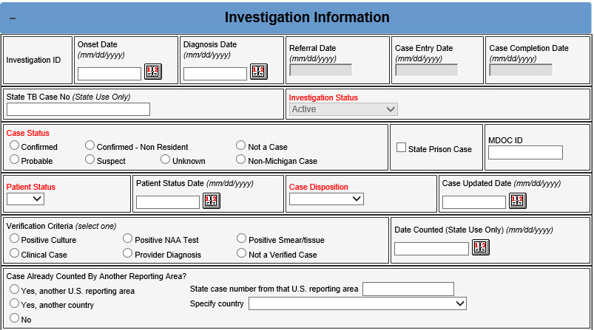
Administrative information
Date of Illness Onset/Symptom Start Date
Date Reported (Referral Date)
Date Counted
State Case Number
Case Already Counted by Another Reporting Area?

Slide 4
Administrative information
Date of Illness Onset/Symptom Start Date
Date Reported (Referral Date)
Date Counted
State Case Number
Case Already Counted by Another Reporting Area?
Date illness/symptoms started for this TB episode
Purpose: To establish the approximate symptom start date to facilitate calculation of infectious period and time from illness onset to diagnosis.
2020 RVCT Reference Manual pg. 45
Notes:
Note: Some symptoms of TB can be nonspecific. The symptom onset date should be recorded as the approximate time when the patient first noticed one or more of the following TB symptoms:
Severe cough that lasted at least 3 weeks
Chest pain not explained by another condition
Coughing up blood or sputum
Night sweats
Persistent fever not explained by another condition
Unintentional weight loss not explained by another condition

Slide 5
Administrative information
Date of Illness Onset/Symptom Start Date
Date Reported (Referral Date)
Date Counted
State Case Number
Case Already Counted by Another Reporting Area?
Date that a health department first thought that the patient may have TB or
Date the health department received notification (verbal or written) from a health care provider that a person might have TB
Purpose: The Date Reported is used to determine when the health department was first notified that a person may have TB.
2020 RVCT Reference Manual pg. 10
Notes:
Comment: If the patient had a previous diagnosis of TB, Date Reported applies to the current TB episode.

Slide 6
Administrative information
Date of Illness Onset/Symptom Start Date
Date Reported (Referral Date)
Date Counted
State Case Number
Case Already Counted by Another Reporting Area?
Date when the state health department verified that the case meets the case definition for TB disease.
This will always be entered by the MDHHS TB Unit
Purpose: Used to determine the approximate date that the reporting area reviewed the RVCT and determined that the case meets the official TB surveillance case definition.
2020 RVCT Reference Manual pg. 11

Slide 7
Administrative information
Date of Illness Onset/Symptom Start Date
Date Reported (Referral Date)
Date Counted
State Case Number
Case Already Counted by Another Reporting Area?
Year + State + Number = State Case Number
Year Reported is the year when the case was reported (e.g. 2020)
State Code indicates the two-letter postal code of the state reporting this case (e.g. MI)
Nine-character string unique within the reporting area
This will always be entered by the MDHHS TB Unit
Purpose: Used to uniquely identify case reports to facilitate communication between reporting areas and CDC
2020 RVCT Reference Manual pg. 12
Notes:
Note:
The State Case Number is the official identification number for the case. If additional communication about a record is required between CDC and a reporting area, this number is used to identify the record. The State Case Number is also commonly known as the RVCT number.
Case numbers must not include personal identifiers. To maintain patient confidentiality, do not use names (either patient or provider), initials, Social Security numbers, addresses, telephone numbers, or other information that could directly identify a patient as part of the State Case Number. State Case Numbers are transmitted to CDC and therefore must not include personal identifying information.

Slide 8
Administrative information
Date of Illness Onset/Symptom Start Date
Date Reported (Referral Date)
Date Counted
State Case Number
Case Already Counted by Another Reporting Area?
Specify whether the case has been counted by another U.S. reporting area or another county. If so, specify the U.S. reporting area state case number or country. This will usually be entered by the MDHHS TB Unit
Purpose: TB cases may be reported by multiple reporting areas in the event that the patient moved between reporting areas while under care for a TB episode; however, to avoid double-counting the case, it is important that only one reporting area officially “count” the case. This question helps to determine whether the case report should be considered “countable” for incidence calculations.
2020 RVCT Reference Manual pg. 14
Notes:
Note: U.S. Reporting Areas
U.S. reporting areas include the 50 United States, the District of Columbia, New York City (separate from New York State), five U.S. Territories (i.e., Puerto Rico, American Samoa, Guam, Commonwealth of the Northern Mariana Islands, U.S. Virgin Islands), and three freely associated states (Federated States of Micronesia, Republic of the Marshall Islands, and Republic of Palau). These freely associated states are independent countries but are considered U.S. reporting areas for TB surveillance purposes.

Slide 9
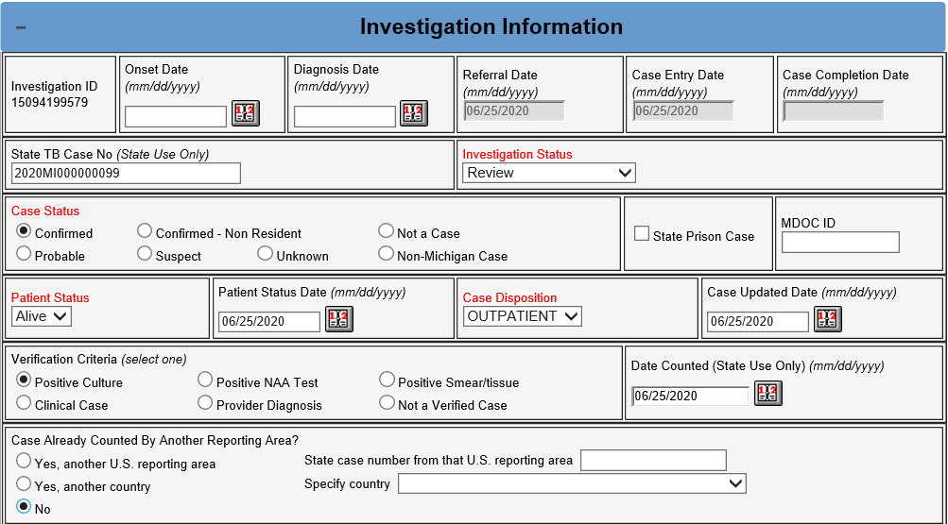

Slide 10
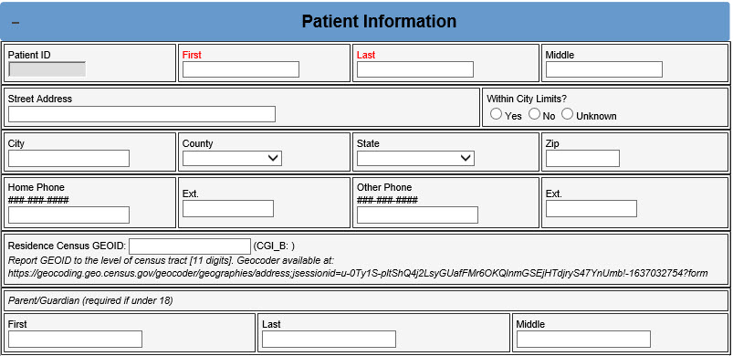
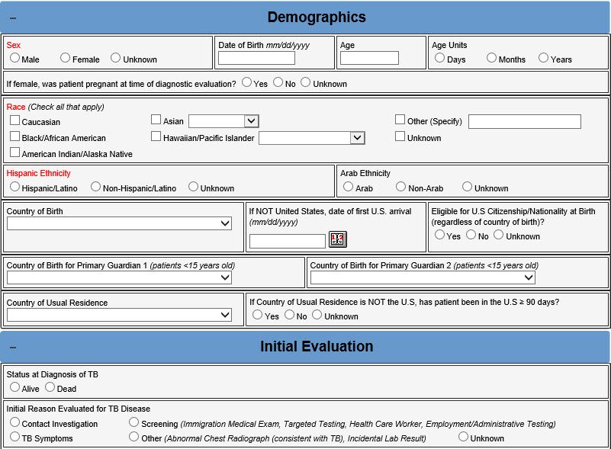
Demographics & Initial Evaluation
Reporting Address
Date of Birth
Sex at Birth
Ethnicity
Race
Nativity
Country of Usual Residence
Status at TB Diagnosis
Initial Reason Evaluated for TB

Slide 11
Demographics & Initial Evaluation
Reporting Address
Date of Birth
Sex at Birth
Ethnicity
Race
Nativity
Country of Usual Residence
Status at TB Diagnosis
Initial Reason Evaluated for TB
Purpose: To document the approximate location of the patient’s residence for the purpose of geographic analyses and correct assignment of the case to a public health jurisdiction.
2020 RVCT Reference Manual pg. 15

Slide 12
Demographics & Initial Evaluation
Reporting Address
Date of Birth
Sex at Birth
Ethnicity
Race
Nativity
Country of Usual Residence
Status at TB Diagnosis
Initial Reason Evaluated for TB
Purpose: To document the approximate location of the patient’s residence for the purpose of geographic analyses and correct assignment of the case to a public health jurisdiction.
If the address is correctly entered the GEOID will automatically population WITHIN (CGI_B: ). This will usually be copied in the text field by the MDHHS TB Unit
2020 RVCT Reference Manual pg. 15
Notes:
Note: Report GEOID to the level of census tract (11 digits). Some surveillance data systems might have the capability to automatically geocode the patient’s address. When manual geocoding is required, use of the U.S. Census Geocoder is recommended. If the patient’s residence does not have a conventional street address, use the following instructions to geocode the patient’s residence using geographic coordinates: For patients whose residence does not have a street address for use in the U.S. Census Geocoder (e.g., some Native American reservations, U.S. territories), the patient’s residence can still be geocoded based on the geographic coordinates of the residence. The following instructions are for Google Maps; however, any mapping application can be used to obtain the latitude and longitude coordinates to enter into the geocoder application:
Find the physical location of the patient’s residence and display this location on the map within your web browser.
Hover your pointer over the approximate location (zoom in on the map as close as possible for maximum accuracy) of the patient’s residence and right-click to display the context menu.
Select “What’s Here?” from the context menu to pop up an information box at the bottom of the window that includes the location’s latitude and longitude coordinates.
Go to the U.S. Census Geocoder Geographic Coordinates search page and copy and paste the exact coordinates from the Google Maps window into the “X” and “Y” fields, including any minus signs, then click the “Find” button. IMPORTANT: The “X” field is for the longitude and the “Y” field is for the latitude.
Scroll down to the “Census Tracts” section and copy the 11-digit GEOID from that section. This is the GEOID to enter on the RVCT.
The freely associated states that are U.S. reporting areas (Federated States of Micronesia, Republic of the Marshall Islands, and Republic of Palau) do not have U.S. census tracts. For cases in these reporting areas, leave the GEOID field blank.

Slide 13
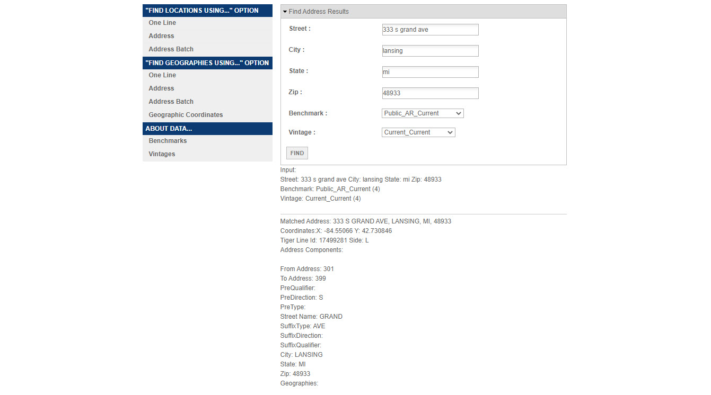
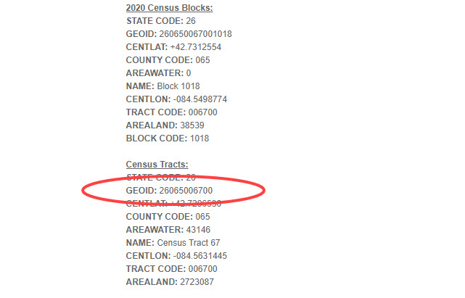
https://geocoding.geo.census.gov/geocoder/geographies/address;jsessionid=u-0Ty1S-pltShQ4j2LsyGUafFMr6OKQlnmGSEjHTdjryS47YnUmb!-1637032754?form

Slide 14
Demographics & Initial Evaluation
Reporting Address
Date of Birth
Sex at Birth
Ethnicity
Race
Nativity
Country of Usual Residence
Status at TB Diagnosis
Initial Reason Evaluated for TB
Purpose: To document the approximate location of the patient’s residence for the purpose of geographic analyses and correct assignment of the case to a public health jurisdiction.
If the address is correctly entered the GEOID will automatically population WITHIN (CGI_B: ). This will usually be copied in the text field by the MDHHS TB Unit
2020 RVCT Reference Manual pg. 15
Notes:
Example on Slide 25

Slide 15
Demographics & Initial Evaluation
Reporting Address
Date of Birth
Sex at Birth
Ethnicity
Race
Nativity
Country of Usual Residence
Status at TB Diagnosis
Initial Reason Evaluated for TB
Patient’s complete date of birth should be entered.
Purpose: To calculate the patient’s age at the time of relevant events in the patient’s lifetime
2020 RVCT Reference Manual pg. 17

Slide 16
Demographics & Initial Evaluation
Reporting Address
Date of Birth
Sex at Birth
Ethnicity
Race
Nativity
Country of Usual Residence
Status at TB Diagnosis
Initial Reason Evaluated for TB
Purpose: To establish the biological sex for the patient at birth for evaluation of epidemiologic trends
IF recorded female at birth, record if patient was pregnant when TB diagnostic evaluation was initiated.
2020 RVCT Reference Manual pg. 18

Slide 17
Demographics & Initial Evaluation
Reporting Address
Date of Birth
Sex at Birth
Ethnicity
Race
Nativity
Country of Usual Residence
Status at TB Diagnosis
Initial Reason Evaluated for TB
Purpose: To establish the biological sex for the patient at birth for evaluation of epidemiologic trends
IF recorded female at birth, record if patient was pregnant when TB diagnostic evaluation was initiated.
2020 RVCT Reference Manual pg. 18

Slide 18
Demographics & Initial Evaluation
Reporting Address
Date of Birth
Sex at Birth
Ethnicity
Race
Nativity
Country of Usual Residence
Status at TB Diagnosis
Initial Reason Evaluated for TB
Purpose: To establish the patient’s ethnicity for evaluation of epidemiologic trends associated with ethnicity
2020 RVCT Reference Manual pg. 19
Notes:
Note: Self-identity or self-reporting
The response to this item should be based on the patient’s self-identity or self-reporting.
It should not be based on physical appearance or surname.
Example: Not Hispanic or Latino but has a Hispanic name
A patient may have a Hispanic name but may not be Hispanic or Latino. For example, if a woman who is not Hispanic marries a Hispanic man, she may self-report as “Not Hispanic or Latino.” Similarly, people from the Philippines may have Hispanic names, but self-report as “Not Hispanic.”

Slide 19
Demographics & Initial Evaluation
Reporting Address
Date of Birth
Sex at Birth
Ethnicity
Race
Nativity
Country of Usual Residence
Status at TB Diagnosis
Initial Reason Evaluated for TB
Purpose: To establish the patient’s race(s) for evaluation of epidemiologic trends associated with race.
2020 RVCT Reference Manual pg. 20-21
Notes:
Note: Self-identity or self-reporting
The response to this item should be based on the patient’s self-identity or self-reporting.
Therefore, patients should be offered the option of selecting more than one racial designation. Non-Hispanic patients who report more than one race will be reported as “multiple race” in national surveillance data summaries.
For Asian or Native Hawaiian or Other Pacific Islander, use the detailed race categories on the next page to complete Specify. The chart below indicates who is considered Asian and who is considered Native Hawaiian or other Pacific Islander.

Slide 20
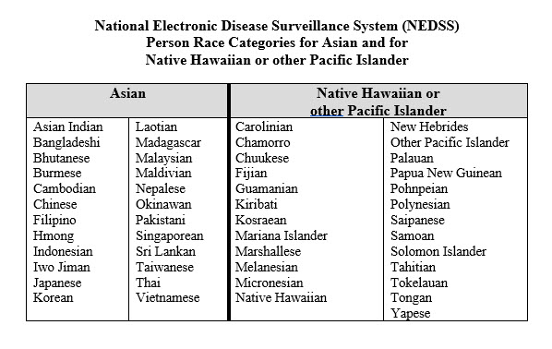

Slide 21
Demographics & Initial Evaluation
Reporting Address
Date of Birth
Sex at Birth
Ethnicity
Race
Nativity
Country of Usual Residence
Status at TB Diagnosis
Initial Reason Evaluated for TB
Purpose: To establish the patient’s country of birth and citizenship status at birth for evaluation of epidemiologic trends.
2020 RVCT Reference Manual pg. 22-23
Notes:
Note: Country of birth. In order to distinguish persons who were born in another country (whether they had U.S. citizenship by birthright) from those who were born in the United States, this question simply asks to record the actual country of birth.
Citizenship at birth. This information is requested because the U.S. Census Bureau bases its “native-born” and “foreign-born” population estimates on this characteristic. As CDC uses the U.S. Census Bureau population estimates as denominator data in calculating incidence rates, this information is needed to correctly categorize TB patients as U.S.-born or non-U.S.–born.

Slide 22
Demographics & Initial Evaluation
Reporting Address
Date of Birth
Sex at Birth
Ethnicity
Race
Nativity
Country of Usual Residence
Status at TB Diagnosis
Initial Reason Evaluated for TB
Country where the patient usually resides.
Purpose: To determine whether a patient was a resident of the United States at the time of diagnosis.
2020 RVCT Reference Manual pg. 24
Notes:
Note: Summary of updated guidelines for determining “country of usual residence”
The Council of State and Territorial Epidemiologists (CSTE) recommends that cases of nationally notifiable diseases should be reported to CDC by the jurisdiction of the person’s “usual residence” at the time of disease onset. The following information has been adapted from CSTE position statement 11-SI-04 (“Revised Guidelines for Determining Residency for Disease Notification Purposes”). In addition, because notifiable disease data are often combined with population data, case notification guidelines based on census residence rules will contribute toward greater consistency in the numerator and denominator data used in disease rates.
Usual residence is defined as the place where the person lives and sleeps most of the time, which is not necessarily the same as the person's voting residence, legal residence, or the place where they became infected with a notifiable disease. Determining usual residence for most people is easy and unambiguous. However, the usual residence for some people is not obvious.
Persons, regardless of citizenship, who have established a household or are part of an established household (i.e., a “usual residence”) in the United States should be reported with a country of usual residence of “United States.” This includes persons who are in the United States for an extended period for work or study, even if they do not consider the United States to be “home.”
Persons (including U.S. citizens) whose established household is outside of the United States (e.g., they are “just visiting”) should be reported with a country of usual residence that is the country where they have established a household (including persons born in a U.S. territory or a freely associated state).
Persons with established households in more than one country should have country of usual residence determined based on which country they spent the most time in during the year preceding diagnosis.

Slide 23
Demographics & Initial Evaluation
Reporting Address
Date of Birth
Sex at Birth
Ethnicity
Race
Nativity
Country of Usual Residence
Status at TB Diagnosis
Initial Reason Evaluated for TB
Purpose: To determine if the patient was alive at the time of TB diagnosis
2020 RVCT Reference Manual pg. 25

Slide 24
Demographics & Initial Evaluation
Reporting Address
Date of Birth
Sex at Birth
Ethnicity
Race
Nativity
Country of Usual Residence
Status at TB Diagnosis
Initial Reason Evaluated for TB
Purpose: To ascertain trends in how TB cases came to the attention of the medical or public health establishment
2020 RVCT Reference Manual pg. 26
Notes:
Note: Select the single initial reason the patient was evaluated for TB disease. The definition of “initial reason” is the situation or reason that led to the initial evaluation for TB disease. If the patient was referred for evaluation, but the reason for the evaluation is unknown, try to determine that reason.
Example: TB Symptoms
If a TB patient was initially encountered via a contact investigation and during that investigation was also noted to have TB symptoms, select Contact Investigation as the initial reason for the evaluation. However, if a patient seeks medical care because of TB symptoms, select TB Symptoms as the initial reason for the evaluation.

Slide 25
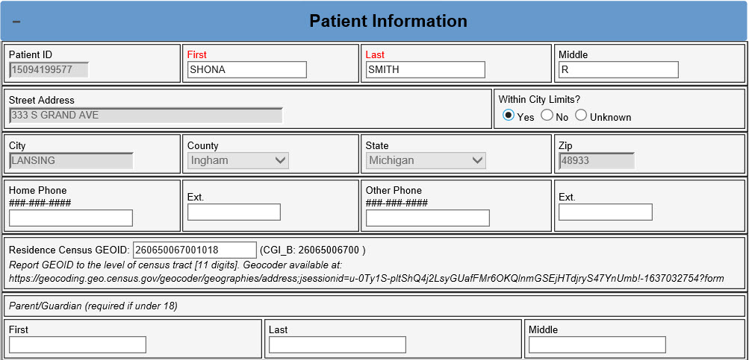

Slide 26
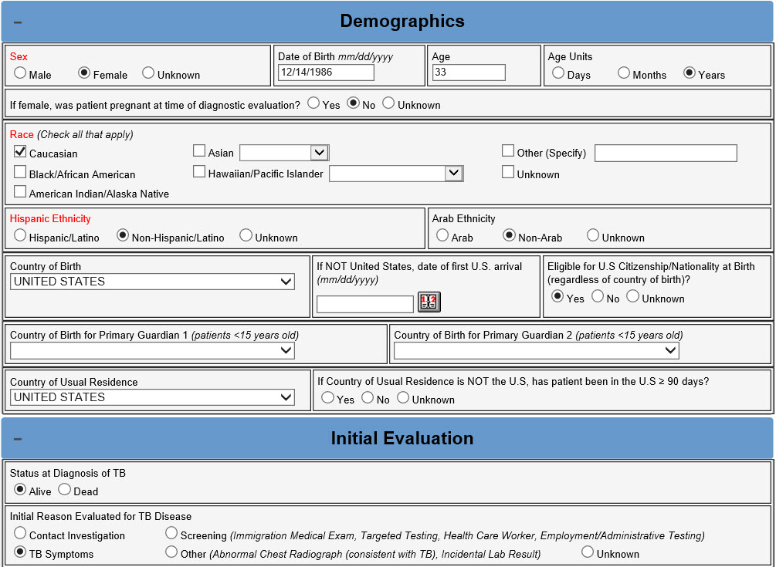

Slide 27
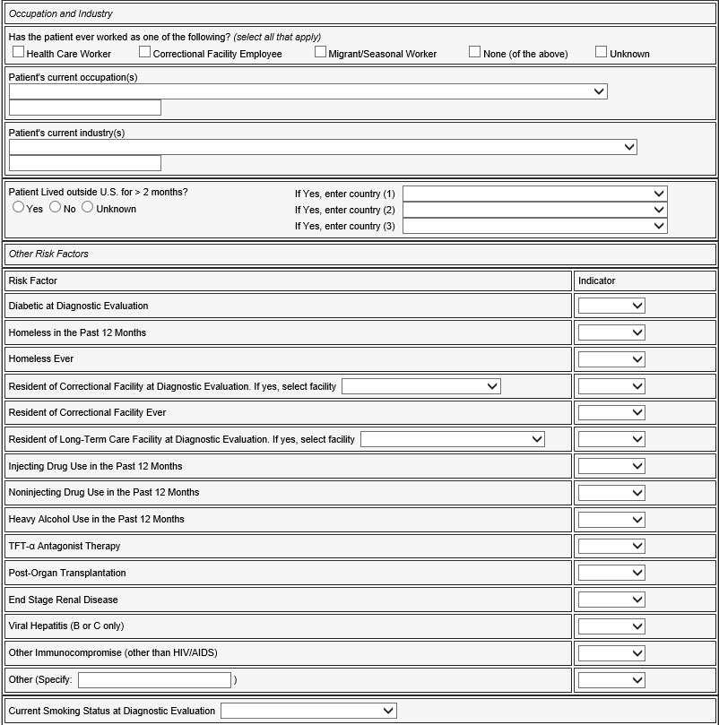
Risk factors
Occupation and Industry
Lived outside the United States for >2 months (uninterrupted)?
Other Risk Factors
If Resident of Correctional Facility at Diagnostic Evaluation, Type of Facility?
If Resident of Long-Term Care Facility at Diagnostic Evaluation, Type of Facility?
Current Smoking Status at Diagnostic Evaluation

Slide 28
Risk factors
Occupation and Industry
Lived outside the United States for >2 months (uninterrupted)?
Other Risk Factors
If Resident of Correctional Facility at Diagnostic Evaluation, Type of Facility?
If Resident of Long-Term Care Facility at Diagnostic Evaluation, Type of Facility?
Current Smoking Status at Diagnostic Evaluation
Purpose: To evaluate potential associations between workplace exposures and TB by collecting information about the person’s current occupations and industries.
You only need to type into text box. You do not need to select the drop-downs.
2020 RVCT Reference Manual pg. 27-29

Slide 29
Risk factors
Occupation and Industry
Lived outside the United States for >2 months (uninterrupted)?
Other Risk Factors
If Resident of Correctional Facility at Diagnostic Evaluation, Type of Facility?
If Resident of Long-Term Care Facility at Diagnostic Evaluation, Type of Facility?
Current Smoking Status at Diagnostic Evaluation
Indicate if patient resided or traveled outside the U.S. for 2 or more months, uninterrupted.
Purpose: To determine the extent to which persons with TB have traveled to countries that might pose a higher risk of TB exposure
2020 RVCT Reference Manual pg. 37
Notes:
Comment: Lived outside the United States
Lived outside the United States refers to the place where a person stayed or slept most of the time, or the place the person considered home during the stated period.
Example: Yes, lived outside the United States in as many as 3 countries for a total of more than 2 uninterrupted months
From January 1 to March 15, the patient lived outside the United States
Lived in Zambia for 10 weeks, then
Returned to the United States
Example: Yes, lived outside the United States in as many as 3 countries for a total of more than 2 uninterrupted months
From January 1 to March 15 the patient lived outside the United States
Lived in Zambia for 4 weeks, then
Lived in South Africa for 3 weeks, then
Lived in Botswana 3 weeks, then
Returned to the United States
Example: No, lived outside the United States in as many as 3 countries for a total of more than 2 months, but travel was interrupted
From January 1 – March 15 the patient lived outside the United States
Lived in Zambia for 5 weeks, then
Returned to the United States for 2 weeks, then
Lived in South Africa for 5 weeks, then
Returned to the United States

Slide 30
Risk factors
Occupation and Industry
Lived outside the United States for >2 months (uninterrupted)?
Other Risk Factors
If Resident of Correctional Facility at Diagnostic Evaluation, Type of Facility?
If Resident of Long-Term Care Facility at Diagnostic Evaluation, Type of Facility?
Current Smoking Status at Diagnostic Evaluation
Indicate whether patient has one or more of the listed risk factors.
Purpose: To evaluate potential risk factors for TB disease
2020 RVCT Reference Manual pg. 30-32
Notes:
Note:
Definition for Diabetic
The American Diabetes Association (American Diabetes Association. Dia Care. 2014;37:S81-S90) has established the following criteria for a diagnosis of diabetes:
Hemoglobin A1c ≥6.5%, or
Fasting (defined as no caloric intake for ≥8 hours) plasma glucose ≥126 mg/dL (7.0 mmol/L), or
2-hour plasma glucose ≥200 mg/dL (11.1 mmol/L) during an oral glucose tolerance test, as described by the World Health Organization, or
In a patient with classic symptoms of hyperglycemia or hyperglycemic crisis, a random plasma glucose ≥200 mg/dL (11.1 mmol/L)
Persons who do not meet the above criteria only because they are currently receiving treatment for diabetes should still be reported as diabetic.
Definitions for Homeless
A homeless person may be an individual who has:
No fixed, regular, and adequate nighttime residence, and
A primary nighttime residence that is
A supervised publicly or privately operated shelter designed to provide temporary living
accommodations, including welfare hotels, congregate shelters, and transitional housing for the mentally ill, or
An institution that provides a temporary residence for individuals intended to be
institutionalized, or
A public or private place not designated for, or ordinarily used as, a regular sleeping
accommodation for human beings.
A homeless person may also be defined as a person who has no home (e.g., is not paying rent, does not own a home, and is not steadily living with relatives or friends). Persons in unstable housing situations (e.g., alternating between multiple residences for short stays of uncertain duration) may also be considered homeless.
A homeless person may be a person who lacks customary and regular access to a conventional dwelling or residence. Included as homeless are persons who live on streets or in nonresidential buildings. Also included are residents of homeless shelters and shelters for battered women. Residents of welfare hotels and single room occupancy (SRO) hotels could also be considered homeless. In the rural setting, where there are usually few shelters, a homeless person may live in nonresidential structures, or substandard housing, or with relatives. Homeless does not refer to a person who is imprisoned or in a correctional facility.
Definition of Injecting Drug Use
Injecting drug use involves the use of hypodermic needles and syringes for the injection of drugs not prescribed by a health care provider. Route of administration may be intravenous, subcutaneous (e.g., skin popping), or intramuscular.
Commonly injected drugs
Heroin and other opiates (e.g., Demerol, Dilaudid, morphine, fentanyl)
Cocaine (e.g., speedball)
Methamphetamines
Amphetamines
Phencyclidine (PCP, angel dust)
Other hallucinogens
Barbiturates
Steroids
Other hormones
Other stimulants
Definition of Noninjecting Drug Use
Noninjecting drug use involves the use of licensed or prescription drugs or other drugs that were not injected and were not prescribed for the patient by a health care provider or approved for over-the-counter use by FDA, or misuse of prescribed drugs. The drugs may be ingested, inhaled, sniffed, or smoked. Marijuana use should always be recorded as noninjecting drug use, regardless of whether marijuana is legal for medicinal or recreational use in the state of residence.
Heavy Alcohol Use in the Past 12 Months
Heavy alcohol use is defined as binge drinking on 5 or more days in the month preceding diagnosis. Binge drinking is defined as a pattern of drinking that bring blood alcohol concentration levels to 0.08 g/dL. This typically occurs after four drinks for women and five drinks for men in about 2 hours.

Slide 31
Risk factors
Occupation and Industry
Lived outside the United States for >2 months (uninterrupted)?
Other Risk Factors
If Resident of Correctional Facility at Diagnostic Evaluation, Type of Facility?
If Resident of Long-Term Care Facility at Diagnostic Evaluation, Type of Facility?
Current Smoking Status at Diagnostic Evaluation
Specify whether the case
Purpose: To categorize the type of correctional facility for those patients who were residing in a correctional facility at the time of diagnostic evaluation.
2020 RVCT Reference Manual pg. 33
Notes:
Note: If the TB patient was a resident of more than one facility during the diagnostic evaluation, select the facility where the initial TB diagnostic evaluation was performed. This question should only be completed if “Resident of Correctional Facility at Diagnostic Evaluation” is answered as “Yes” in question 16.

Slide 32
Risk factors
Occupation and Industry
Lived outside the United States for >2 months (uninterrupted)?
Other Risk Factors
If Resident of Correctional Facility at Diagnostic Evaluation, Type of Facility?
If Resident of Long-Term Care Facility at Diagnostic Evaluation, Type of Facility?
Current Smoking Status at Diagnostic Evaluation
Specify whether the case
Purpose: To categorize the type of long-term care facility for those patients who were residing in a long-term care facility at the time of diagnostic evaluation.
2020 RVCT Reference Manual pg. 34-35
Notes:
Note: If the TB patient was a resident of more than one facility during the diagnostic evaluation, select the facility where the initial TB diagnostic evaluation was performed. This question should only be completed if “Resident of Long-Term Care Facility at Diagnostic Evaluation” is answered as “Yes” in question 16.

Slide 33
Risk factors
Occupation and Industry
Lived outside the United States for >2 months (uninterrupted)?
Other Risk Factors
If Resident of Correctional Facility at Diagnostic Evaluation, Type of Facility?
If Resident of Long-Term Care Facility at Diagnostic Evaluation, Type of Facility?
Current Smoking Status at Diagnostic Evaluation
Indicate whether patient is current, former, or never smoker. If current, indicate frequency.
Purpose: Surveillance and patient management. To assess factors that may complicate testing, treatment, and follow-up.
2020 RVCT Reference Manual pg. 36
Notes:
Note: The definition of smoking includes consumption of tobacco (or nicotine) through combustible tobacco products (e.g., cigarettes) or electronic nicotine delivery systems (ENDS; e.g., vapes or e-cigarettes). It does not include chewing tobacco. Smoking of substances other than tobacco (e.g., marijuana) should be recorded under noninjecting drug use.
Source: U.S. Food and Drug Administration. (2018). Vaporizers, E-Cigarettes, and other Electronic Nicotine Delivery Systems (ENDS). Retrieved from:
https://www.fda.gov/TobaccoProducts/Labeling/ProductsIngredientsComponents/ucm456610.htm

Slide 34
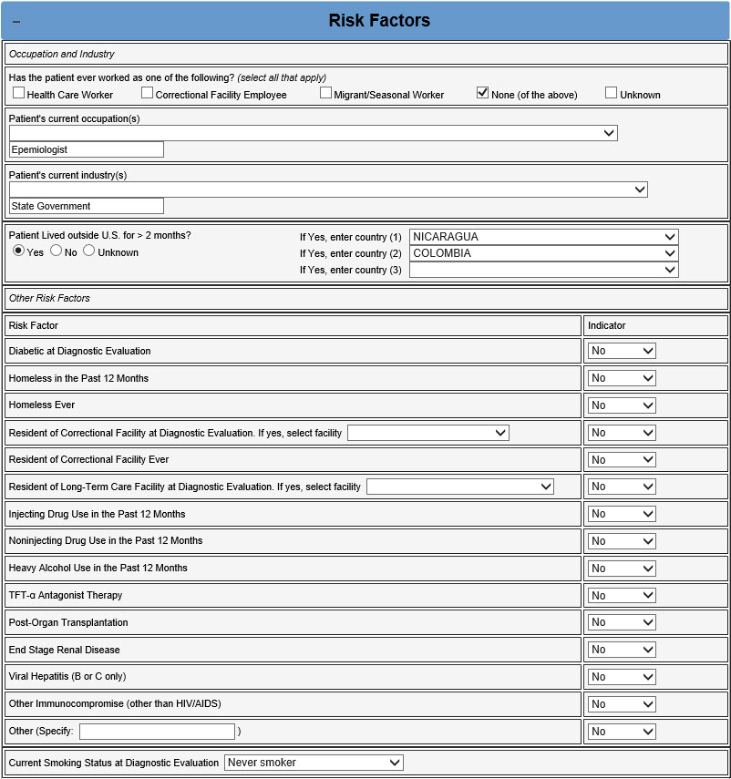
Epidemiologist

Slide 35
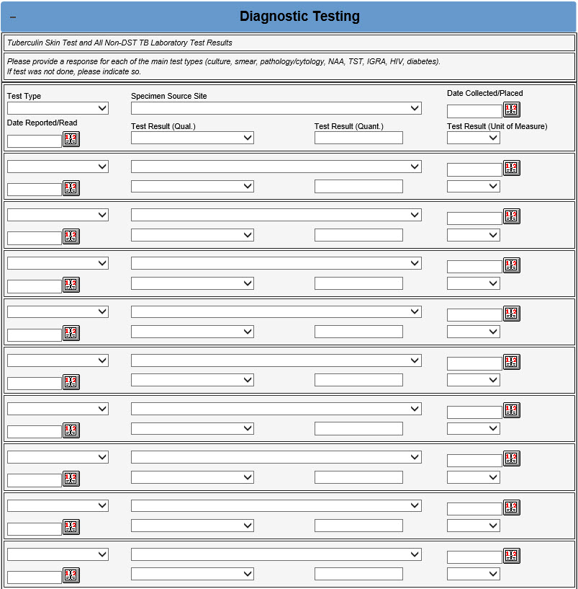
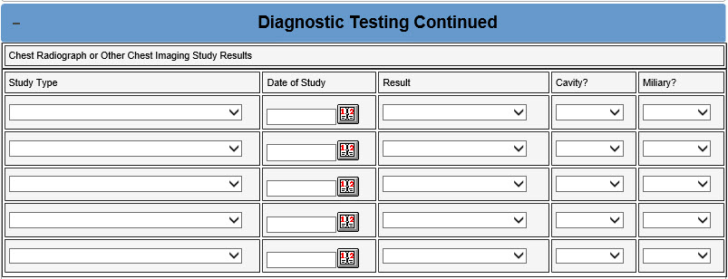
Diagnostic testing
Tuberculin Skin Test and All Non-DST TB Laboratory Test Results
Chest Radiograph and Other Imaging Study Result

Slide 36
Diagnostic testing
Tuberculin Skin Test and All Non-DST TB Laboratory Test Results
Chest Radiograph and Other Imaging Study Result
Always specify test results/status for at least initial TST, initial IGRA, initial sputum smear, initial sputum culture, initial NAA, and initial HIV test.
If diabetic also report a Hemoglobin A1c.
If HIV positive also report CD4 count.
Also include the initial result of smear and culture performed on a specimen other than sputum.
Purpose: To verify that the case meets the surveillance definition for TB and to identify laboratory test characteristics of TB cases.
2020 RVCT Reference Manual pg. 38-41
Notes:
MINIMUM REQUIREMENTS:
Always enter initial TST, initial IGRA, initial sputum smear, initial sputum culture, initial NAAT, and initial HIV test. Enter "Not Done" if for any tests that were not done in this case.
CD4 count should be reported for HIV-positive persons. Hemoglobin A1c or fasting blood glucose at diagnostic evaluation should be reported for diabetic patients. Also include the initial result of any other tests performed that are in the test type value set. If a type of test was done on different specimen sources, include the initial result for each unique combination of test type and specimen source.
Follow-up testing should be done according to CDC guidelines and local clinical judgment. For tests that are done multiple times, only those results for each combination of test type and specimen source where the result changed (e.g., positive to negative) should be entered.
Note: Results of the tuberculin skin test (TST) should be interpreted according to Table 7 of the currently accepted guidelines (www.cdc.gov/mmwr/PDF/rr/rr4906.pdf).

Slide 37
Diagnostic testing
Tuberculin Skin Test and All Non-DST TB Laboratory Test Results
Chest Radiograph and Other Imaging Study Result
Always specify study type and result/status for at least Initial plain chest x-ray and initial chest CT scan. Enter “Not Done” as applicable. Multiple results may be entered.
Also include the initial result of any other chest imaging studies performed (i.e. MRI or PET)
Purpose: To verify that the case meets the surveillance definition for TB and to identify imaging test characteristics of TB cases.
2020 RVCT Reference Manual pg. 42-43
Notes:
Note: Miliary TB is a serious type of TB disease. It is a clinical or radiologic finding, rather than a site of disease. Miliary TB is the result of a TB infection eroding into the bloodstream and from there disseminating throughout the body to multiple organs. It appears on radiographs as a great number of small (1- to 2-mm), well-defined nodules that look like millet seeds scattered throughout the lungs, hence the name “miliary.”
MINIMUM REQUIREMENTS: Initial plain chest x-ray; initial chest CT scan. Enter "Not Done" if applicable. Also include the initial result of any other chest imaging studies performed that are in the test type value set (i.e., MRI, PET). Subsequent results for each chest imaging study type should be entered if the result changed. Note if cavity or miliary lesions are identified for each study.
Note: The minimum requirement is the initial plain chest x-ray or initial chest CT scan result; however, multiple results may be entered into the table.

Slide 38
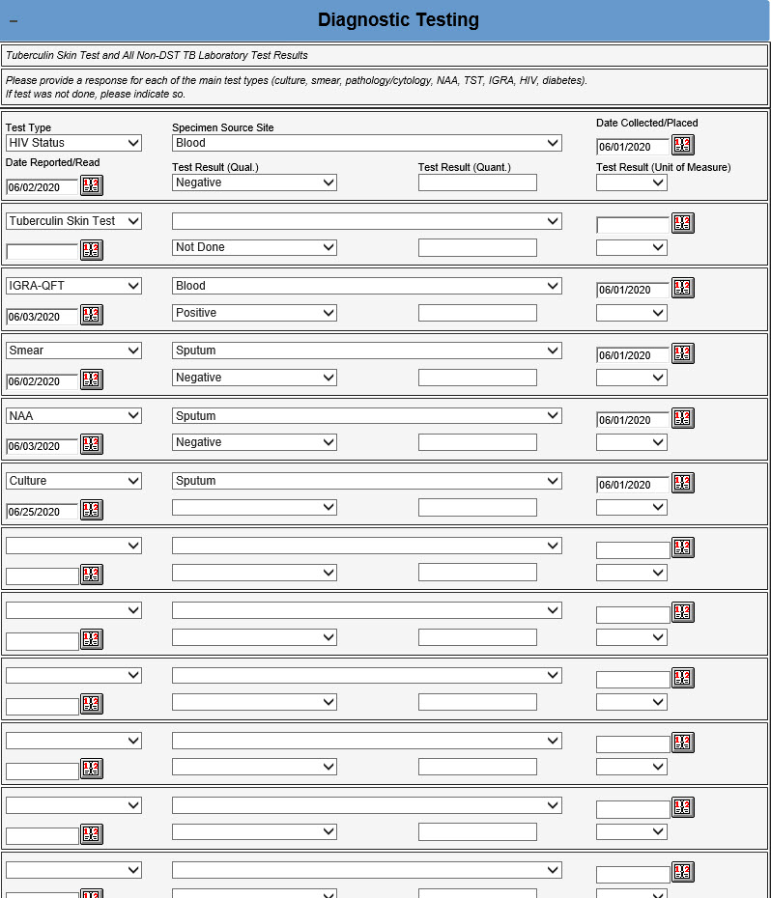

Slide 39
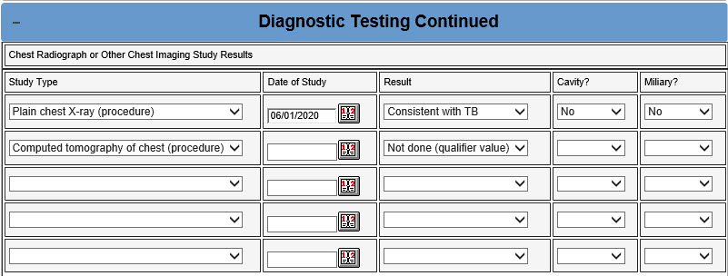

Slide 40
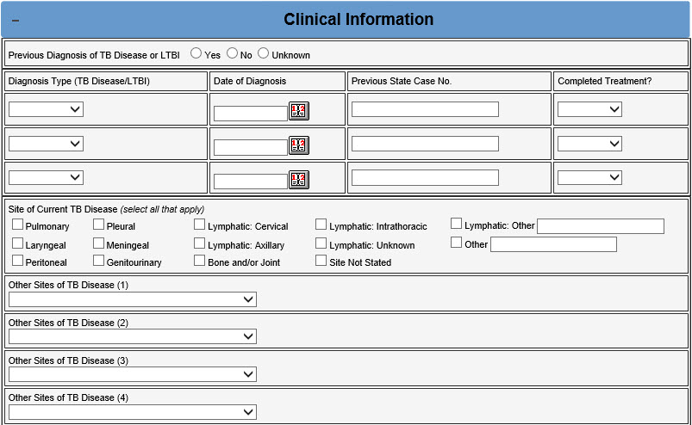
Clinical history & findings
Has the Patient been Previously Diagnosed with TB Disease or LTBI?
Site of TB Disease

Slide 41
Clinical history & findings
Has the Patient been Previously Diagnosed with TB Disease or LTBI?
Site of TB Disease
Specify whether the patient had a previous diagnosis of either TB disease or LTBI. If yes, specify whether TB or LTBI, approximate date of diagnosis, previous state case number (if TB), and whether they completed a full course of appropriate treatment.
Purpose: To determine whether the patient has a prior history of TB disease or LTBI
2020 RVCT Reference Manual pg. 44

Slide 42
Clinical history & findings
Has the Patient been Previously Diagnosed with TB Disease or LTBI?
Site of TB Disease
Select all anatomic sites where TB disease was identified in the patient by checking the relevant box. If there is not a corresponding check box, record the site in “other” and select it from the “other sites of TB disease” drop down.
If there is evidence of more than one organ or disease site involved, select all involved sites.
Purpose: To document site of TB disease
2020 RVCT Reference Manual pg. 46
Notes:
Note: If there is evidence that more than one organ or disease site is involved, select all involved sites of disease. “Pulmonary” has been replaced with “Lung Structure” in the provided list.
Miliary TB
This form has no place to select miliary TB in Site of Disease (item 25). If the report of the initial chest radiograph or the initial chest CT scan indicates “miliary TB or a miliary or bilateral micronodular pattern,” record this finding under Initial Chest Radiograph (item 22) and enter “Lung Structure” as a Site of Disease (item 25).

Slide 43
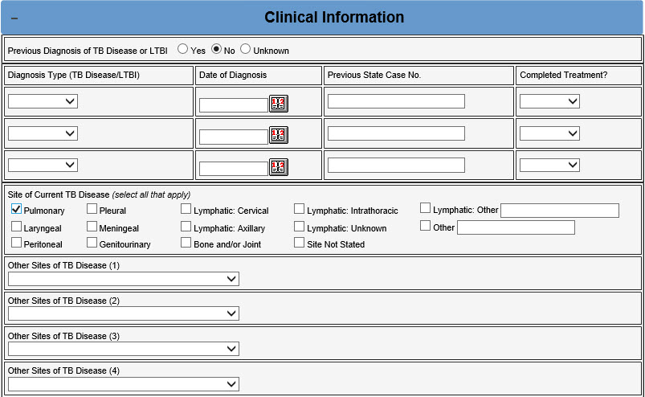

Slide 44
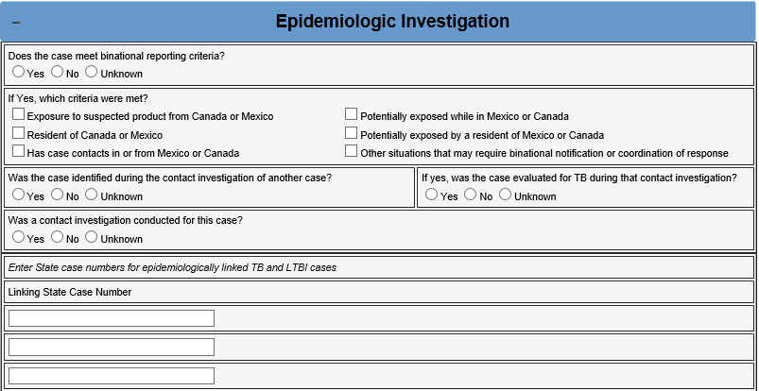
Epidemiologic investigation
Case Meets Binational Reporting Criteria?
Case Identified During a Contact Investigation of Another Case?
Contact Investigation Conducted for This Case?
Table of Known TB and LTBI Cases Epidemiologically Linked to This Case

Slide 45
Epidemiologic investigation
Case Meets Binational Reporting Criteria?
Case Identified During a Contact Investigation of Another Case?
Contact Investigation Conducted for This Case?
Table of Known TB and LTBI Cases Epidemiologically Linked to This Case
Indicate whether the case meets one of the criteria listed below to be classified as a binational case.
If yes, select all criteria that were met.
Purpose: To determine whether the case meets binational reporting criteria
2020 RVCT Reference Manual pg. 47-48
Notes:
Note: Information on Council of State and Territorial Epidemiologists (CSTE) binational case criteria is available in CSTE position statement 13-SI-02 (www.cste.org/resource/resmgr/PS/13-SI-02.pdf)
Information on the TB-specific binational case definition used to define “other situations that might require binational notification or coordination or response” is available in:
Woodruff RSY, Miner MC, Miramontes R. Development of a Surveillance Definition for United States–Mexico Binational Cases of Tuberculosis. Public Health Reports 2018;133(2):155–162.
https://journals.sagepub.com/doi/pdf/10.1177/0033354918760575

Slide 46
Epidemiologic investigation
Case Meets Binational Reporting Criteria?
Case Identified During a Contact Investigation of Another Case?
Contact Investigation Conducted for This Case?
Table of Known TB and LTBI Cases Epidemiologically Linked to This Case
Indicate whether the case had been identified during another case’s contact investigation. If yes, indicate whether the patient was evaluated for TB disease during that investigation.
Purpose: To determine whether the case was identified during the contact investigation of another TB case.
2020 RVCT Reference Manual pg. 49

Slide 47
Epidemiologic investigation
Case Meets Binational Reporting Criteria?
Case Identified During a Contact Investigation of Another Case?
Contact Investigation Conducted for This Case?
Table of Known TB and LTBI Cases Epidemiologically Linked to This Case
Indicate whether there a contact investigation was initiated for this case.
Note: The question should be answered “yes” if a CI was conducted that adequately identified contacts related to this case, even if the investigation was prompted by identification of a different case.
Purpose: To determine if a contact investigation was performed around this case.
2020 RVCT Reference Manual pg. 50
Notes:
Note: Contact investigations are often conducted based on a location, e.g., workplace, household. This question should be answered “yes” if a contact investigation was conducted that adequately identified contacts related to this case, even if the investigation was prompted by identification of a different case (ex: child diagnosed after exposure to grandparent but all contact were tested in grandparent’s investigation).

Slide 48
Epidemiologic investigation
Case Meets Binational Reporting Criteria?
Case Identified During a Contact Investigation of Another Case?
Contact Investigation Conducted for This Case?
Table of Known TB and LTBI Cases Epidemiologically Linked to This Case
Specify state case number (ex: 2020MI000000000) for all cases epidemiologically linked to this case.
This will usually be entered by the MDHHS TB Unit
Purpose: To determine potential transmission links between cases.
2020 RVCT Reference Manual pg. 51
Notes:
Note: For this variable, an “epidemiologic link” is defined as either a definite or probable link:
Definite: patients shared airspace at the same location at the same time during one case's infectious period
Probable: patients shared airspace at the same location during the same general time period, but investigator unable to document that they were there at the same time during one case's infectious period

Slide 49
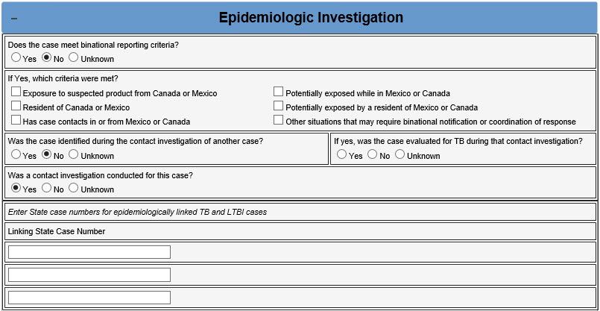

Slide 50
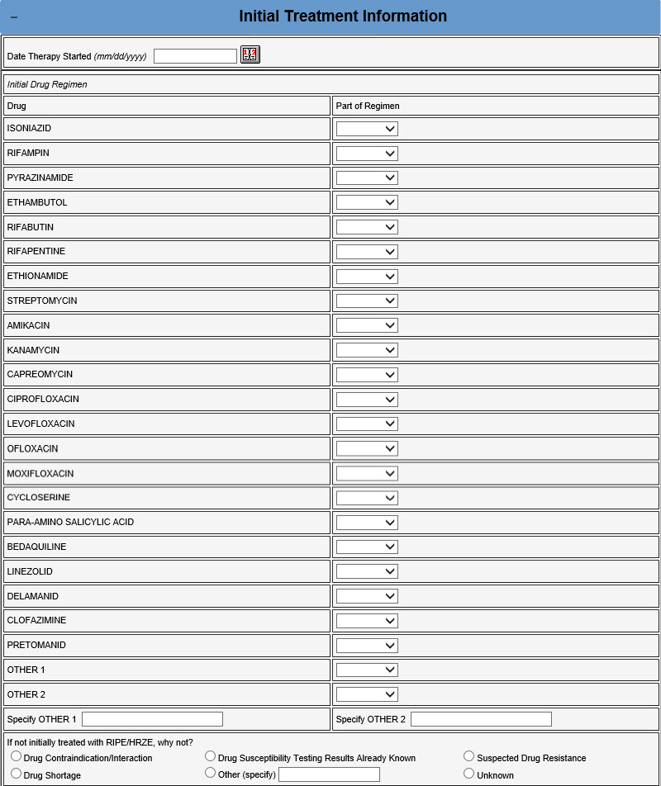
Initial treatment information
Date Therapy Started
Initial Drug Regimen
If Initial Drug Regimen Not RIPE/HRZE, Why Not?

Slide 51
Initial treatment information
Date Therapy Started
Initial Drug Regimen
If Initial Drug Regimen Not RIPE/HRZE, Why Not?
Date the patient began multidrug therapy for confirmed or possible TB disease.
Preferred: Date the patient first ingested medication if documented in a medical record or DOT
Next Alternative: Date medication was first dispensed to the patient as documented by medical or pharmacy record
Last Alternative: Date medication was first prescribed to the patient by the health care provider as documented by a medical or pharmacy record
Purpose: To calculate program management indicators
2020 RVCT Reference Manual pg. 52
Notes:
Note: Date Therapy Started is the month, day, and year the patient began drug therapy for confirmed or possible TB disease. Patient history without medical documentation is not acceptable and should be entered as unknown.

Slide 52
Initial treatment information
Date Therapy Started
Initial Drug Regimen
If Initial Drug Regimen Not RIPE/HRZE, Why Not?
For each drug named, indicate whether it was used/prescribed in the initial regimen for treatment of TB disease.
Purpose: To calculate program management indicators
2020 RVCT Reference Manual pg. 53
Notes:
Note: Combination drugs
For combination drugs, select Yes for each drug that is a component of the combination drug, e.g., for Rifater (combination of isoniazid, rifampin, and pyrazinamide):

Slide 53
Initial treatment information
Date Therapy Started
Initial Drug Regimen
If Initial Drug Regimen Not RIPE/HRZE, Why Not?
If the initial TB treatment regimen was not Isoniazid, Rifampin, Pyrazinamide, and Ethambutol, indicate the reason why.
Only complete if RIPE was not used.
Ex: DST results already known, contraindication, suspected resistance, shortage
Purpose: To calculate program management indicators
2020 RVCT Reference Manual pg. 54
Notes:
Note: This question should only be completed if the standard initial four-drug therapy (RIPE/HRZE, i.e., isoniazid, rifampin, pyrazinamide, and ethambutol) was not used for this patient as recorded in above.

Slide 54
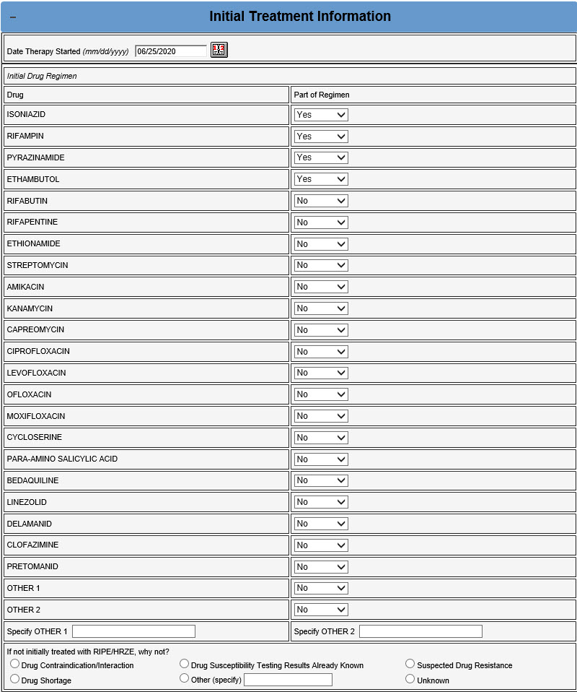

Slide 55
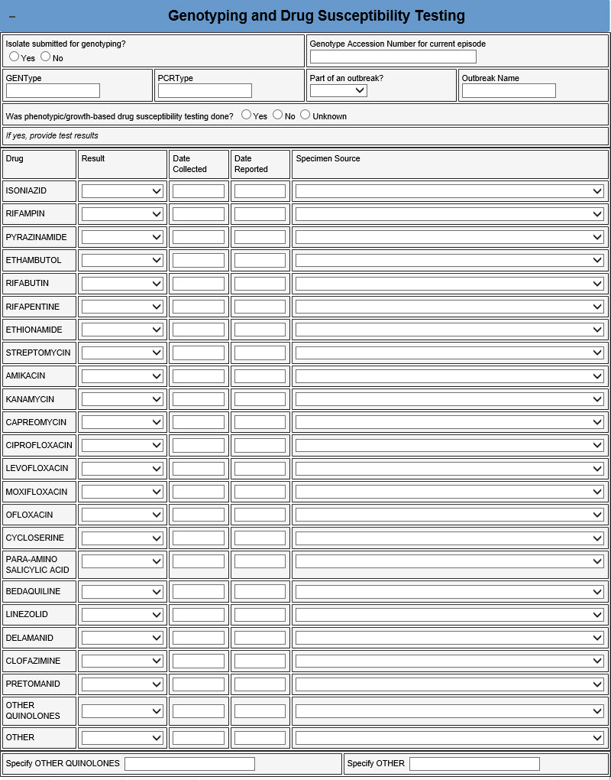
Genotyping & drug susceptibility testing
Isolate Submitted for Genotyping?
Was Phenotypic/Growth-Based Drug Susceptibility Testing Done?
Was Genotyping/Molecular Drug Susceptibility Done?
Was the Patient Treated as an MDR TB Case (Regardless of DST Results)?

Slide 56
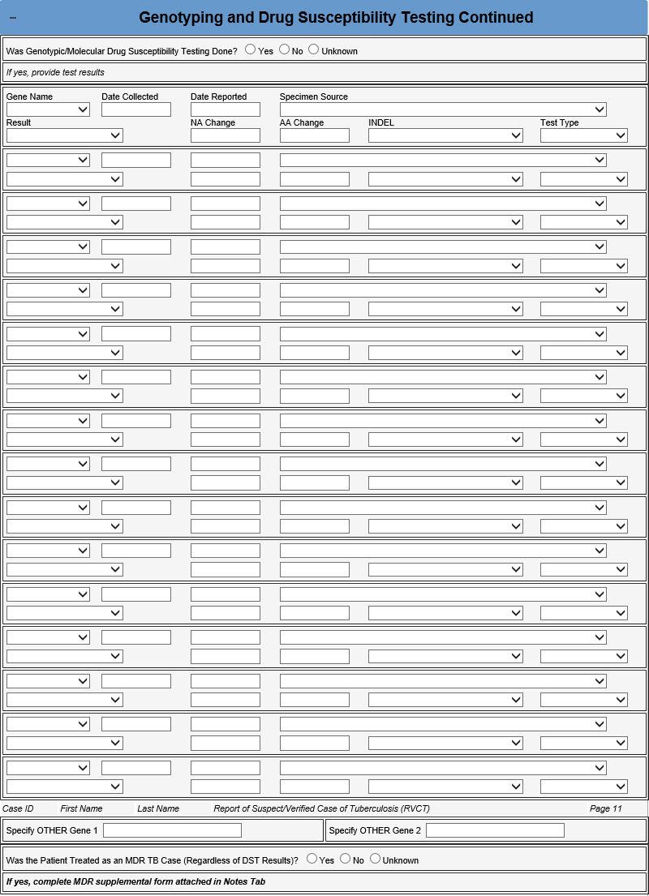
Genotyping & drug susceptibility testing
Isolate Submitted for Genotyping?
Was Phenotypic/Growth-Based Drug Susceptibility Testing Done?
Was Genotyping/Molecular Drug Susceptibility Done?
Was the Patient Treated as an MDR TB Case (Regardless of DST Results)?

Slide 57
Genotyping & drug susceptibility testing
Isolate Submitted for Genotyping?
Was Phenotypic/Growth-Based Drug Susceptibility Testing Done?
Was Genotyping/Molecular Drug Susceptibility Done?
Was the Patient Treated as an MDR TB Case (Regardless of DST Results)?
Indicate whether an isolate was submitted for genotyping. If yes, enter the genotype accession number.
This will always be entered by the MDHHS TB Unit
Purpose: To link genotyping results with RVCT data
2020 RVCT Reference Manual pg. 55
Notes:
Note: Genotyping accession number
In 2004, CDC established the National Tuberculosis Genotyping Service (NTGS). The goal was to genotype one M. tuberculosis isolate from every culture-confirmed TB case in the United States. The genotyping accession number is the number assigned by the genotyping reference laboratory. Currently, the numbers are formatted as YY (the 2-digit year), followed by “RF” and 4 digits (e.g., “06RF5678”). This format might change in the future.

Slide 58
Genotyping & drug susceptibility testing
Isolate Submitted for Genotyping?
Was Phenotypic/Growth-Based Drug Susceptibility Testing Done?
Was Genotyping/Molecular Drug Susceptibility Done?
Was the Patient Treated as an MDR TB Case (Regardless of DST Results)?
Indicate whether growth-based DST was performed.
If yes, complete the table with result for each drug tested, specimen type, date collected, and date reported.
This will usually be entered by the MDHHS TB Unit
Purpose: To identify TB cases with drug-resistant isolates using phenotypic/growth-based drug susceptibility testing methods.
2020 RVCT Reference Manual pg. 56
Notes:
Note: Include initial result for all unique combinations of drug tested and specimen type as well as any subsequent tests where the result changed when new test results become available.

Slide 59
Genotyping & drug susceptibility testing
Isolate Submitted for Genotyping?
Was Phenotypic/Growth-Based Drug Susceptibility Testing Done?
Was Genotyping/Molecular Drug Susceptibility Done?
Was the Patient Treated as an MDR TB Case (Regardless of DST Results)?
Indicate whether molecular drug susceptibility testing was performed (i.e. MDDR or GeneXpert MTB/RIF).
If yes, complete the table for each gene tested.
This will always be entered by the MDHHS TB Unit
Purpose: Provides information on test results for genetic mutation associated with drug resistance.
2020 RVCT Reference Manual pg. 57-58
Notes:
Note: Include initial result for each combination of gene and test type as well as any subsequent tests where the result changed when new test results become available.
See 2020 RVCT Reference Manual Appendix E for additional instructions on completing this question, including examples.

Slide 60
Genotyping & drug susceptibility testing
Isolate Submitted for Genotyping?
Was Phenotypic/Growth-Based Drug Susceptibility Testing Done?
Was Genotyping/Molecular Drug Susceptibility Done?
Was the Patient Treated as an MDR TB Case (Regardless of DST Results)?
Indicate whether the patient was treated as an MDR TB Case.
If yes, complete the supplemental form that will be attached in the “Notes” tab.
Purpose: To determine whether a patient was treated as a multidrug-resistance (MDR) TB case, regardless of laboratory results.
2020 RVCT Reference Manual pg. 59
Notes:
Note:
Sometimes, TB cases are treated as if they were MDR TB, even if laboratory results are not available to confirm the MDR TB diagnosis. These cases should have “Yes” entered for this question. If you selected Yes, complete the MDR TB supplemental form (2020 RVCT Reference Manual Appendix G) that will be attached to the “Notes” tab.
Do not mark this question as “Yes” if second-line TB drugs were used for reasons other than possible or confirmed drug resistance, e.g., drug sensitivity or shortage.

Slide 61
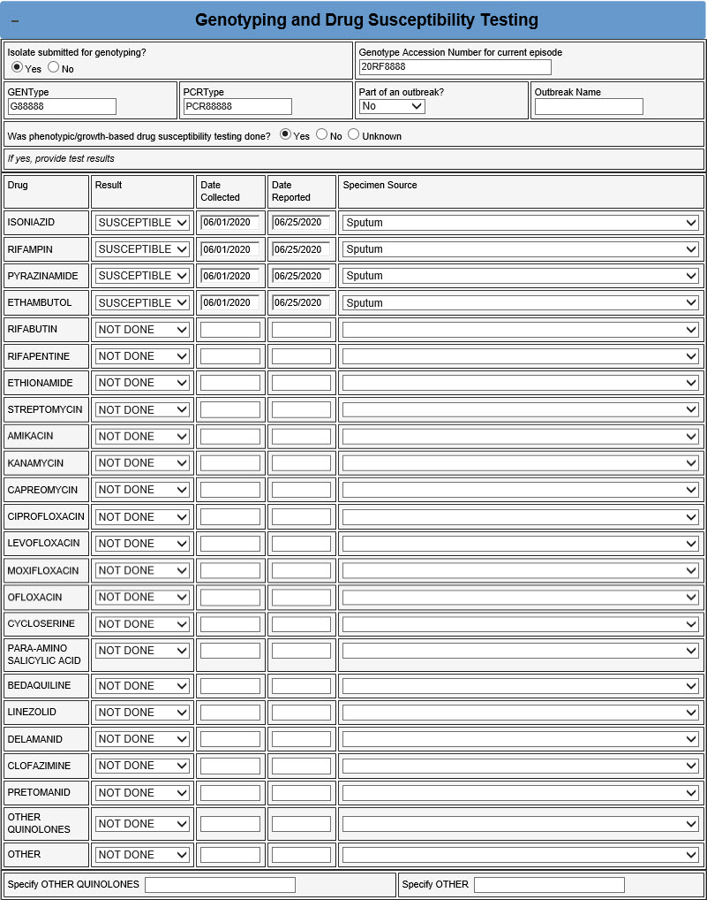

Slide 62
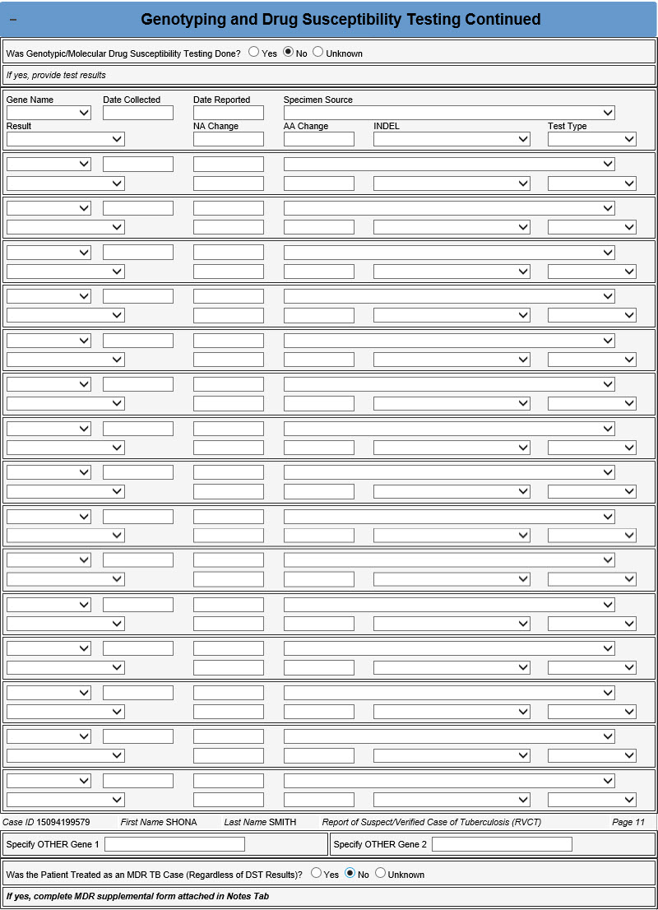

Slide 63
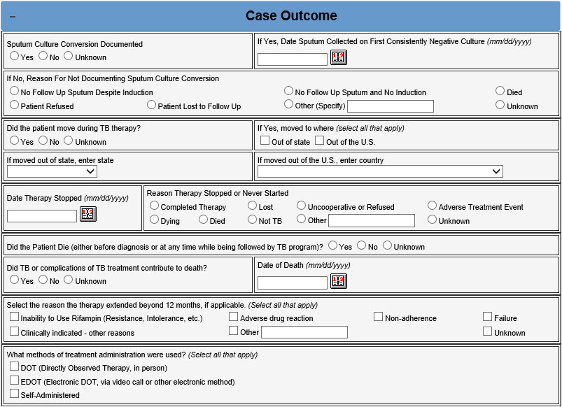
Case outcome
Sputum Culture Conversion Documented?
Moved During Therapy?
Date Therapy Stopped
Reason Therapy Stopped or Never Started?
Reason TB Disease Therapy Extended >12 Months, if applicable
Treatment Administration
Did the Patient Die (either before diagnosis or at any time while being follow by TB program)?
Notes:
.

Slide 64
Case outcome
Sputum Culture Conversion Documented?
Moved During Therapy?
Date Therapy Stopped
Reason Therapy Stopped or Never Started?
Reason TB Disease Therapy Extended >12 Months, if applicable
Treatment Administration
Did the Patient Die (either before diagnosis or at any time while being follow by TB program)?
Only for cases where the initial sputum specimen was culture-positive, indicate if it was followed by at least one negative sputum culture (not within initial set of sputa).
If yes, enter the date the first negative specimen was collected. If no, select the reason for not documenting sputum culture conversion.
Purpose: To monitor the rate of sputum culture conversion
2020 RVCT Reference Manual pg. 60-61
Notes:
Note:
Provide information on sputum culture conversion only for patients with initially positive sputum cultures. Sources for documentation of sputum culture conversion include patient medical records and laboratory reports.
This question should be completed once sputum culture conversion is documented. If the patient’s sputum cultures later become positive again, the response to this question should be updated.

Slide 65
Case outcome
Sputum Culture Conversion Documented?
Moved During Therapy?
Date Therapy Stopped
Reason Therapy Stopped or Never Started?
Reason TB Disease Therapy Extended >12 Months, if applicable
Treatment Administration
Did the Patient Die (either before diagnosis or at any time while being follow by TB program)?
Indicate if the patient moved to another reporting area (state or country) during TB treatment.
If yes, indicate whether out of state and/or out of the U.S.
Specify the state and/or country.
Purpose: To facilitate efficient communication between TB control programs in providing continuity of care for the patient.
2020 RVCT Reference Manual pg. 62-63
Notes:
Note: This variable is used to record whether the patient moved during TB therapy. The responsibility for follow-up reporting generally remains with the reporting area that initially reported the case to CDC and counted it. (For a detailed description of the responsibility for submitting follow-up reports to CDC, see the instructions for Reporting Address in the 2020 RVCT Manual.)

Slide 66
Case outcome
Sputum Culture Conversion Documented?
Moved During Therapy?
Date Therapy Stopped
Reason Therapy Stopped or Never Started?
Reason TB Disease Therapy Extended >12 Months, if applicable
Treatment Administration
Did the Patient Die (either before diagnosis or at any time while being follow by TB program)?
Date the patient stopped taking medication for confirmed or possible TB disease.
May be one of several dates, ideally, when the patient last ingested medication if documented in a medical record.
Purpose: To monitor completion of therapy within a specific time
2020 RVCT Reference Manual pg. 64
Notes:
Comment: Date Therapy Stopped
The interval between Date Therapy Started (item 30) and Date Therapy Stopped (item 39) is meant to encompass the entire period (including interruptions in therapy) that the patient was receiving medication to treat confirmed or possible TB disease. Patient self-report without medical documentation is not acceptable. Although there may be interruptions in anti-TB drug therapy, enter the final documented date on which the patient last ingested medication for confirmed or possible TB disease. For patients being treated for confirmed or possible TB disease, enter Date Therapy Stopped, according to the chart in the manual.

Slide 67
Case outcome
Sputum Culture Conversion Documented?
Moved During Therapy?
Date Therapy Stopped
Reason Therapy Stopped or Never Started?
Reason TB Disease Therapy Extended >12 Months, if applicable
Treatment Administration
Did the Patient Die (either before diagnosis or at any time while being follow by TB program)?
Indicate the reason TB therapy was stopped or never started. Usually this is “completed therapy.”
“Other” should be used if patient moved out of state or country and treatment outcome can not be obtained despite attempts.
Purpose: To document treatment outcome
2020 RVCT Reference Manual pg. 65

Slide 68
Case outcome
Sputum Culture Conversion Documented?
Moved During Therapy?
Date Therapy Stopped
Reason Therapy Stopped or Never Started?
Reason TB Disease Therapy Extended >12 Months, if applicable
Treatment Administration
Did the Patient Die (either before diagnosis or at any time while being follow by TB program)?
If TB therapy extended beyond 12 months, specify the reason(s) why.
Purpose: To document reason for extended treatment and to calculate program indicators
2020 RVCT Reference Manual pg. 66
Notes:
Note: Use the information entered for Date Therapy Started and Date Therapy Stopped to calculate the length of anti-TB therapy. Sources for the reason(s) therapy was extended include patient medical records, patient interview, and health care provider interview.

Slide 69
Case outcome
Sputum Culture Conversion Documented?
Moved During Therapy?
Date Therapy Stopped
Reason Therapy Stopped or Never Started?
Reason TB Disease Therapy Extended >12 Months, if applicable
Treatment Administration
Did the Patient Die (either before diagnosis or at any time while being follow by TB program)?
Specify what method(s) of treatment administration were used during the course of TB therapy.
Purpose: To document administration of TB medications.
2020 RVCT Reference Manual pg. 67
Notes:
Note: Directly observed therapy (DOT), or supervised therapy, involves the direct visual observation by a health care provider (e.g., public health nurse, outreach worker, nurse, nurse’s aide) or other reliable trained person (e.g., worker in a homeless shelter) of a patient’s ingestion of medication. Delivering medication to a patient without visual confirmation of ingestion does not constitute DOT. However, electronic confirmation of ingestion of medicine of carefully selected patients (e.g., stable and compliant) constitutes electronic DOT.

Slide 70
Case outcome
Sputum Culture Conversion Documented?
Moved During Therapy?
Date Therapy Stopped
Reason Therapy Stopped or Never Started?
Reason TB Disease Therapy Extended >12 Months, if applicable
Treatment Administration
Did the Patient Die (either before diagnosis or at any time while being follow by TB program)?
Indicate whether the patient died for any reason either before TB diagnosis or at any point after TB diagnosis while the TB program was following the patient.
If yes, enter Date of Death and select whether TB or complication of TB treatment contributed to the death.
Purpose: To collect information on mortality among TB patients.
2020 RVCT Reference Manual pg. 68-69

Slide 71
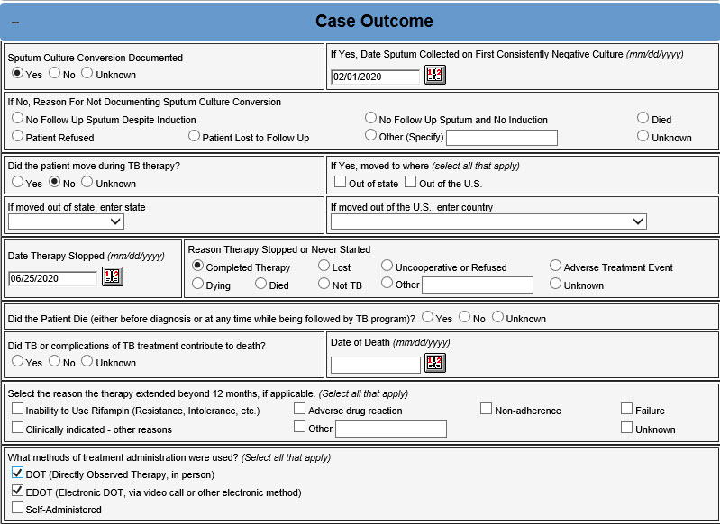

Slide 72
Tuberculosis Case Definition for Public Health Surveillance
Clinical description
A chronic bacterial infection caused by Mycobacterium tuberculosis, usually characterized pathologically by the formation of granulomas. The most common site of infection is the lung, but other organs may be involved.
Clinical criteria
A case that meets all the following criteria:
  A positive tuberculin skin test or positive interferon gamma release assay for M. tuberculosis
  Other signs and symptoms compatible with tuberculosis (TB) (e.g., abnormal chest radiograph, abnormal chest computerized tomography scan or other chest imaging study, or clinical evidence of current disease)
  Treatment with two or more anti-TB medications
  A completed diagnostic evaluation
Laboratory criteria for diagnosis
  Isolation of M. tuberculosis from a clinical specimen,* OR
  Demonstration of M. tuberculosis complex from a clinical specimen by nucleic acid amplification test,** OR
  Demonstration of acid-fast bacilli in a clinical specimen when a culture has not been or cannot be obtained or is falsely negative or contaminated.
Case classification
Confirmed
A case that meets the clinical case definition or is laboratory confirmed.
Notes:
A case should not be counted twice within any consecutive 12-month period. However, a case occurring in a patient who had previously had verified TB disease should be reported and counted again if more than 12 months have elapsed since the patient completed therapy. A case should also be reported and counted again if the patient was lost to supervision for greater than 12 months and TB disease can be verified again. Mycobacterial diseases other than those caused by M. tuberculosis complex should not be counted in tuberculosis morbidity statistics unless there is concurrent tuberculosis.

Slide 73
Thank you!
Questions?
Email smiths79@michigan.gov with questions or concerns

