Slide 1
2025 Annual Performance Report (APR) Guidance

Slide 2
Background
This APR serves as the continuing application for the 2026 Cooperative Agreement (COAG) with CDC.

Slide 3
Due Date
October 20,2025 at 11:59 pm ET

Slide 4
Reporting Period
January 1 – June 30, 2025

Slide 5
Resources
Project Narrative – submitted with the initial grant application package
2025 Notice of Funding Opportunity (NOFO)
NTIP Reports

Slide 6
Outline
Prevention & Control (P&C) – max 40 pages
Human Resources Development (HRD) – max 10 pages
Laboratory Strengthening – max 15 pages

Slide 7
Language to Avoid
Pregnant Person | Diversity (even scientific diversity). Nothing to imply that anything is diverse | Inclusion
Equity, specifically Health Equity | Gender | Race
LGBT (or another other version of any phrase) | Transgender | Non-Binary
They/them pronouns | Bias | Systemic
Privilege | Underrepresented | Civility
Social Justice
https://bsky.app/profile/darbysaxbe.bsky.social/post/3lhcvn4hxwk2o
https://www.forbes.com/sites/brucelee/2025/03/15/these-197-terms-may-trigger-reviews-of-your-nih-nsf-grant-proposals/

Slide 8
Prevention & Control (P&C)
Maximum of 40 pages

Slide 9
Prevention and Control Components
Performance Measures
Evaluation Results
Work Plan - update
Data Management Plan (DMP) – develop and/or update
Successes
Challenges
CDC Program Support to Recipients

Slide 10
Prevention and Control – Performance Measures
Source: NTIP Indicator Summary Report
Step 1: Log into SAMS and select the National TB Indicators Project (NTIP)
Step 2: Accept the Terms for the Rules of Behavior
Step 3: Select the “Report” option at the top of the page
Step 4: Multistep process
Select your “Program Area” from the drop-down menu
Select the “Indicator Summary” report in the Indicator section
Select “Q2” in the Quarter section
Click “View” to access the report

Slide 11
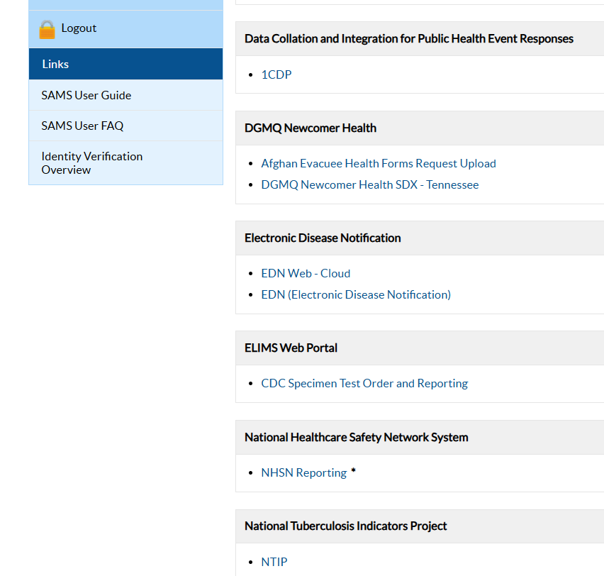
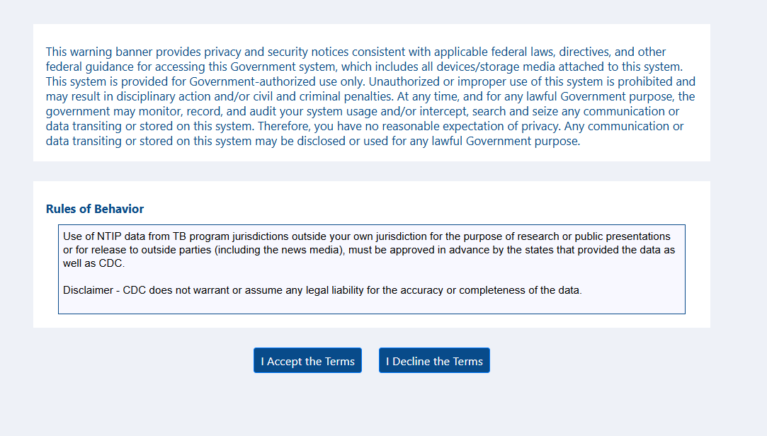
Step 1: Log into SAMS and select NTIP
Step 2: Accept the Terms of the Rules of Behavior

Slide 12

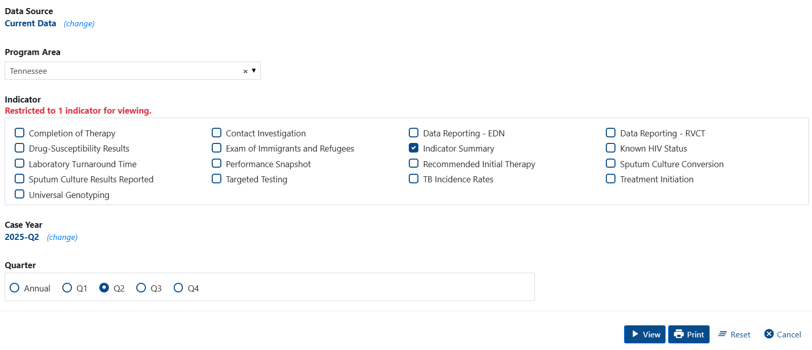
Step 3: Select the “Reports” option at the top of the page
Step 4:
Select your program area
Select “Indicator Summary” in the Indicator section
Select “Q2” in the Quarter section
Click “View”
Select your program area
Select the “Indicator Summary” report
Select Q2

Slide 13
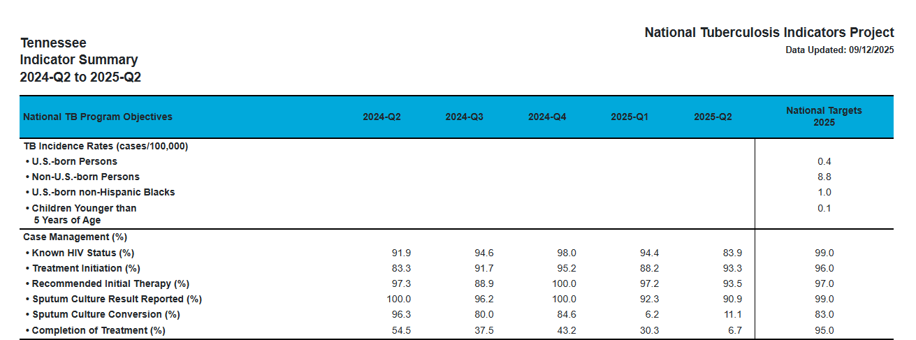

Slide 14
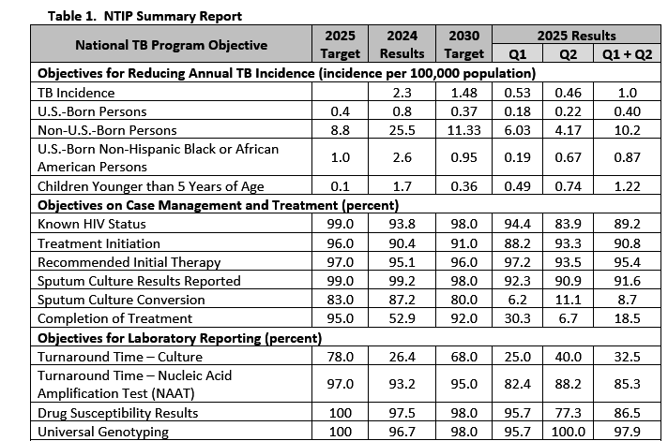
NOTES/CONSIDERATIONS
I included both 2025 and 2030 NTIP targets
To calculate Q1 and Q2 case rates, I used (1) case counts from each quarter and (2) the population estimates in NTIP
For Q1+Q2 – I averaged the two results for Q1 and Q2

Slide 15
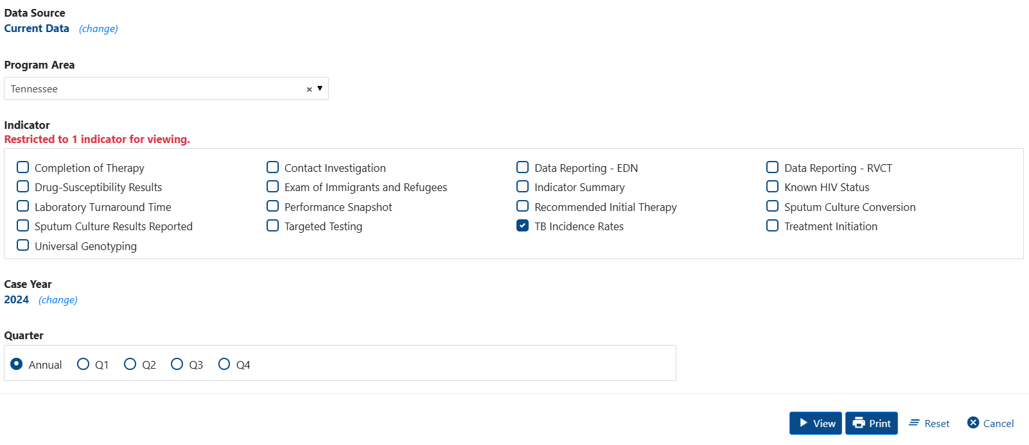
Population Estimates in NTIP
Select your program area
Select the “TB Incidence Rates” report
Select “Annual”

Slide 16

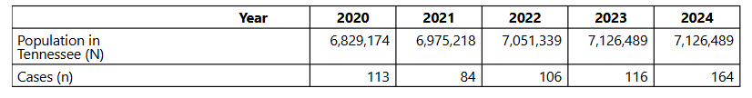


Slide 17
NTIP - Miscellaneous
2030 national NTIP targets can be found at:
https://www.cdc.gov/tb-programs/php/ntip/objectives-and-performance-targets.html

Slide 18
Prevention and Control – Evaluation Results
Report on evaluation results for work completed January 1 – June 30, 2025
Report on any ways that the results of the evaluation plan have affected the program
Include the name and contact information for your program’s Evaluation Focal Point
Additional information to consider including:
Cohort review summary
Date(s) of cohort review(s)
Number of cases discussed
Key issues identified and resolved
Recommendations
New tools or trainings

Slide 19
Prevention and Control – Work Plan
Refer to Notice of Funding Opportunity (FOA) – page 30 of 76
Refer to Work Plan submitted in initial application
Update Work Plan that includes the following work plan strategies:
Strategy 1: Diagnosis and treatment of persons with TB disease
Strategy 2: Conduct contact investigations for infectious TB cases
Strategy 3: Test and treat populations at higher risk for TB and LTBI
Strategy 4: Program planning, monitoring, evaluation, and improvement
Strategy 5: Surveillance
Strategy 6: Human resources development (HRD) and partnerships
Strategy 7: Laboratory strengthening

Slide 20
Strategy 1: Diagnosis and treatment of persons with TB disease
Priority Activity | Programmatic Activities | Successes | Barriers | Benchmarks
Ensure case management and treatment of persons | Conduct annual programmatic reviews to ensure that individuals with active TB disease are assigned a regional case manager, which is documented in the client’s medical record. | During the most recent programmatic assessments, 100% of individuals with active TB disease were assigned a regional TB case manager, which was documented in the client’s medical record. | Staffing continues to be a barrier to ensuring quality case management of individuals with active TB disease, and results in a higher than desired case manager-to-client ratio. | Maintain 100% throughout the grant period.
Assess the adequacy and appropriateness of therapy for each patient. | Ensure therapeutic drug monitoring for all individuals with suspected or confirmed TB disease after two weeks of therapy. | During the first six months of 2025, a total of 134 TDMs were drawn on 81 unique clients. | Collecting therapeutic drug levels after two weeks of therapy has been difficult for clients that are hospitalized. | Increase the proportion of individuals with suspected or confirmed TB disease that have TDMs draw within 2 weeks of treatment to 95% by 2030.

Slide 21
Prevention and Control – Data Management Plan (DMP)
Refer to the initial 2025 COAG submission project narrative for Data Management Plan (DMP) that was submitted and provide updates.
Data Management Plan should include the following:
Description of data to be collected or generated in the proposed project
Standards to be used for the collected and generated data
Mechanisms for or limitations to providing access to or sharing of the data. This section should address access to identifiable and de-identified data or justification for not making the data accessible

Slide 22
Prevention and Control – Data Management Plan (DMP) Components
Data Management Plan should include the following:
Description of data to be collected or generated in the proposed project
Standards to be used for the collected and generated data
Mechanisms for or limitations to providing access to or sharing of the data. This section should address access to identifiable and de-identified data or justification for not making the data accessible
Address provisions for the protection of privacy, confidentiality, security, intellectual property, or other rights
Statement of the use of data standards that ensure all released data have appropriate documentation that describes:
Method of collection
What the data represent
Potential limitations for use
Plans for archiving and long-term preservation of the data or explaining why long-term preservation and access are not justified.

Slide 23
Prevention and Control – Successes
Recipients must report on the progress of completing activities in the Work Plan (see Slide 19)
Recipients must describe any additional successes (identified through evaluation results or lessons learned) achieved in the past year
Examples: implementation of isolation guidelines, increased use of incentives and enablers, increased use of electronic DOT, use of the 4-month HPMZ regimen, etc.
Recipients must describe success stories
Examples: contact investigations, successful case vignette

Slide 24
Prevention and Control - Challenges
Recipients must describe any challenges that might affect their ability to achieve annual and project period outcomes, conduct performance measures, or complete the activities in the work plan (see Slide 19)
Recipients must describe any additional challenges (e.g., identified through evaluation results or lessons learned) encountered in the past year
Examples: drug shortages, staffing shortages, etc.

Slide 25
Prevention and Control – CDC Program Support to Recipients
Recipients must describe how CDC could help them overcome challenges to achieving annual and project-period outcomes and performance measures, and completing activities outlined in the work plan

Slide 26
Human Resources Development (HRD)
Maximum of 10 pages

Slide 27
Human Resources Development (HRD) Work Plan
Refer to Work Plan Strategy 6: Human Resources Development and Partnerships
Refer to initial Work Plan submitted in the 2025 COAG submission
Include the contact information for your program’s Education and Training Focal Point

Slide 28
Strategy 6: Human resources development (HRD) and partnerships
Priority Activity | Programmatic Activities | Successes | Barriers | Benchmarks
Identify an education and training focal point | Assign a new education and training focal point after retirement of previous focal point | One of the program’s nurse consultants has been assigned as the education and training focal point | (1) Additional training required for new education and training focal point (2) Competing priorities of nurse case management and education and training
Identify training opportunities and maintain attendance records | Education and training focal point developed a calendar of known education and training opportunities and distributed to regional TB program staff | During the first six (6) months of the project period, three (3) applicable trainings were identified with 14 central office and regional staff attending | Staff shortages and schedules make it difficult for regional TB program staff to attending education and training opportunities | (1) Provide information on all applicable education and training opportunities to regional TB program staff (2) At least one regional TB program staff member to attend at least one education and training oppotunity

Slide 29
Human Resources Development (HRD)
Additional information to include:
Any education and training needs identified
Have you developed any strategies to improve existing training and to identify ongoing training and HRD needs?
Have you taken any steps to improve patient education and communications capacity within the program?
Have you coordinated any training related to TB control for other disease control interventions such as HIV, VH, and STI?
Have you provided any trainings/education to health care providers or organizations that serve high-risk population?

Slide 30
Laboratory Lab Strengthening
Maximum 15 pages

Slide 31
Laboratory Strengthening - Checklist
One designated laboratory point-of-contact with associated contact information
Name
Title
Email
Telephone number
An organizational chart of mycobacteriology laboratory managers and personnel performing TB testing including names of staff in each position (list vacant if vacant)
Note which staff are awarded (funded) under this cooperative agreement

Slide 32
Laboratory Strengthening – Checklist (continued)
A brief description of laboratory methods and instrumentation use and/or accessed through referral testing
A visual flowchart of the mycobacteriology laboratory testing algorithm
Updated Laboratory Work Plan using previously submitted Excel spreadsheet LCT sent by email
Element 1: Ensure availability of high-quality and timely core TB laboratory services
Updates for previously listed activities to include progress, obstacles experienced, and updated completion date (if applicable)
Description of new activities for achieving stated objectives
Measure of success, anticipated obstacles, responsible staff, and anticipated completion date for each new activity

Slide 33
Laboratory Strengthening – Checklist (continued)
Element 2: Promote continual advancement of laboratory efficiency and quality assurance using laboratory-specific data
Updates for previously listed activities to include progress, obstacles experienced, and updated completion date (if applicable)
Description of new activities related to improvements
Measure of success, anticipated obstacles, responsible staff, and anticipated completion date for each new activity
Element 3: Communicate and collaborate with partners (e.g., healthcare providers, TB Programs, and other laboratories) to ensure optimal use of laboratory services and timely flow of information
Updates for previously listed activities to include progress, obstacles experienced, and updated completion date (if applicable)
Description of new activities related to improvements
Measure of success, anticipated obstacles, responsible staff, and anticipated completion date for each new activity

Slide 34
Laboratory Strengthening – Checklist (continued)
NOTE: Laboratories, regardless of volume, should provide at least two measurable objectives and related activities for Laboratory Elements 2 and 3.

Slide 35
Budget

Slide 36
Budget Preparation Guidelines
https://www.cdc.gov/grants/documents/Budget-Preparation-Guidance.pdf

Slide 37
Budget Documents to Include
Indirect Cost Rate Agreement (attachment)
Interim Federal Financial Report (FFR) SF-425 (if applicable)
https://www.grants.gov/forms/forms-repository/post-award-reporting-forms
Budget narrative

Slide 38
Other Items to Submit

Slide 39
Other Items to Submit
Performance Progress and Monitoring Report (PPMR) OR program’s OMB-approved reporting
SF-LLL Disclosure of Lobbying Activities (online for and instructions), if applicable
https://www.grants.gov/forms/forms-repository/post-award-reporting-forms

Slide 40
Performance Measure Reporting
If applicable, in response to a large outbreak.
Performance Measure Reports should include at a minimum:
Report on activities completed
Outcomes achieved
Challenges experienced
Program improvements, as applicable
Additional support (if any) requested from CDC

Slide 41
Submitting the Application Package

Slide 42
Application Submission Checklist
Performance Progress and Monitoring Report (PPMR) OR reference program’s OMB-approved reporting
SF-424A Budget Information – Non-Construction (online form) and Budget Justification (attachment)
Indirect Cost Rate Agreement (attachment)
Performance Narrative
SF-LLL Disclosure of Lobbying Activities (online form) - https://www.grants.gov/forms/forms-repository/post-award-reporting-forms
Interim Federal Financial Report (FFR) SF-425 (if applicable) - https://www.grants.gov/forms/forms-repository/post-award-reporting-forms
Budget Narrative
Additional Program Requirements (if applicable)
Lab Forms

Slide 43
Submitting the APR
Log into GrantSolutions - https://www.grantsolutions.gov/auth/realms/Grantsolutions/protocol/openid-connect/auth?response_type=code&client_id=gs&redirect_uri=http%3A%2F%2Fwww.grantsolutions.gov%2Fgs%2Fservlet%2Fgrantlist.GranteeGrantListServlet&state=76c6f5bb-5231-4765-a67b-da90dca8f456&login=true&scope=openid
Access your TB grant
Make sure you are accessing the most recent grant

Slide 44
Submitting the APR
Click the “Edit Application” button
Submit the required online forms in “Online Forms”
Submit all other documents in “Additional Information to be Submitted”
Upload each attachment
When finished, click “Verify Submission”

Slide 45
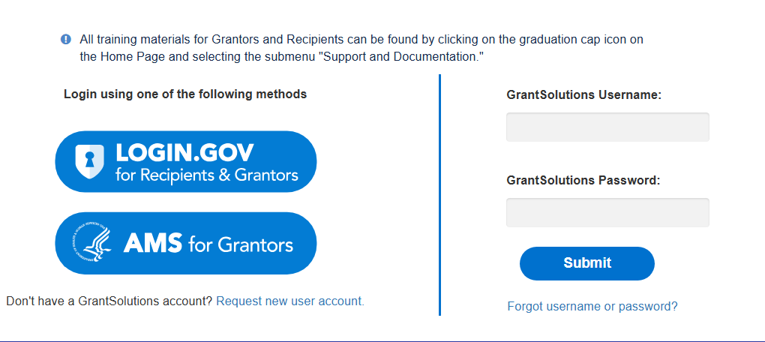
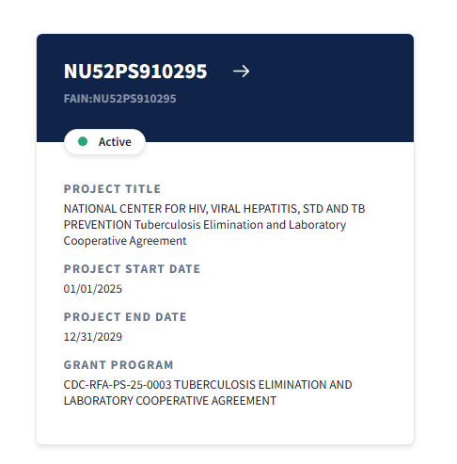
Step 1: Log into GrantSolutions
Step 2: Access your TB grant

Slide 46
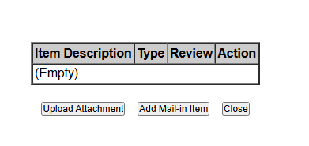
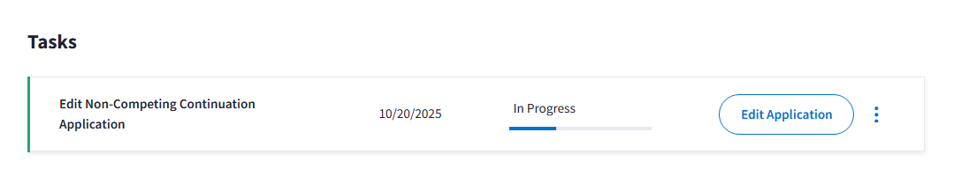
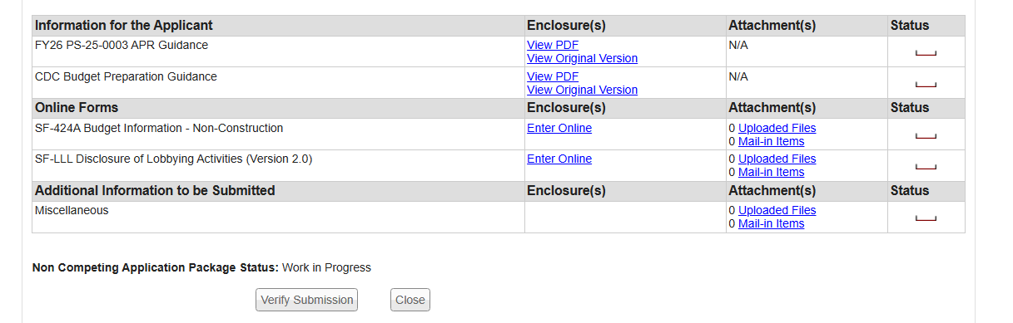
Step 3: Select “Edit Application”
Step 6: Upload each attachment
Step 4: Submit required online forms
Step 5: Submit all other documents in “Additional Information to be Submitted”
Step 7: Click “Verify Submission”

Slide 47
What’s Next?
We will send out an email that includes the following attachments:
APR guidance
Tennessee’s APR template
Tuberculosis Elimination Cooperative Agreement Checklist – 2026, Laboratory Strengthening Component
Laboratory work plan
Additional language to possibly avoid

Slide 48
Looking Ahead - Due December 31, 2025
TB Elimination Plan
Grantees should formulate and implement a plan for the elimination and interruption of transmission of MTB. The plan should be developed and implemented with ongoing collaboration with a TB elimination advisory committee.
TB Workforce Assessment
Regardless of funding source, provide a list of current positions with titles and percent Full Time Equivalent (FTE), both filled and vacant
A list of additional desired positions with titles and percent FTE believed necessary to fully execute the program’s elimination plan
Don’t forget to include state lab staff!

