Slide 1
Aggregate Reports for Program Evaluation (ARPE)

Slide 2
ARPE Due Date and Years Covered
Due March 31, 2026
Data to submit:
Final 2024
Preliminary 2025
Instructions for completing the ARPE are available on CDC’s website at www.cdc.gov/tb-programs/php/arpe/contacts-form.html

Slide 3
Targeted Testing Data
Previously only required if >150 cases
Now required for all jurisdictions regardless of morbidity
Years covered:
2024 (if >150 cases)
2025 (everyone)

Slide 4
Uniting for Ukraine ARPEs
Formal entry requirements ended in 2023.
Complete data for 2022 and 2023.
Any ongoing testing in this population may be recorded in targeted testing.

Slide 5
Logging into SAMS & NTIP

Slide 6
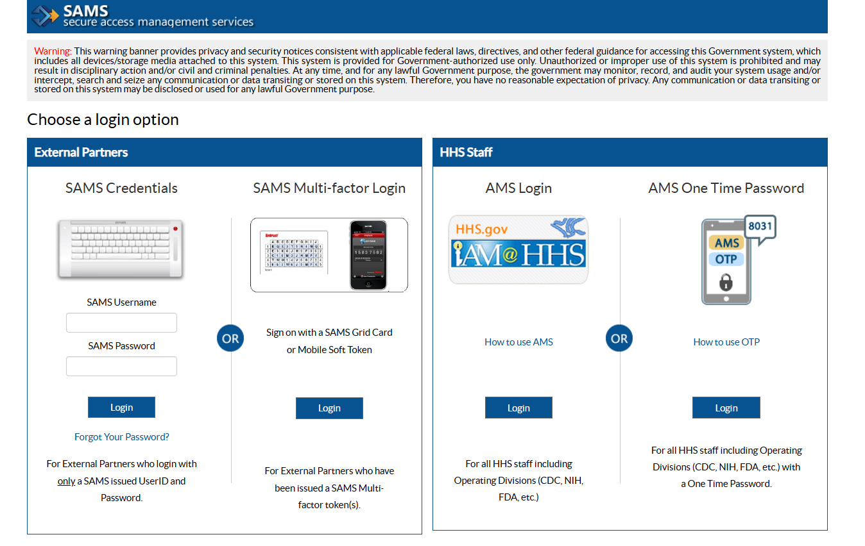
Logging Into SAMS

Slide 7
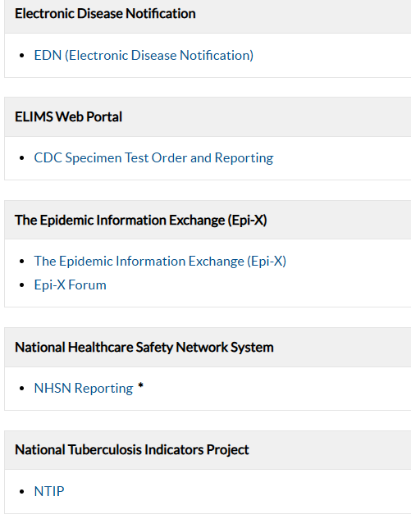
Log Into NTIP

Slide 8
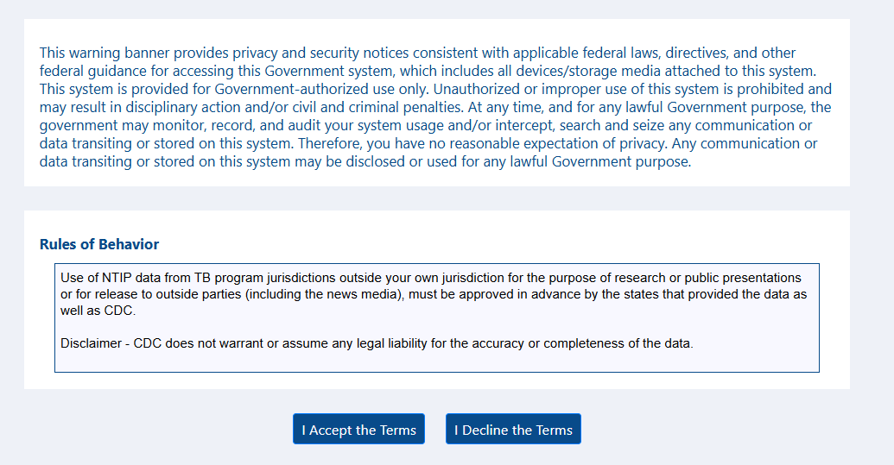
Rules of Behavior

Slide 9
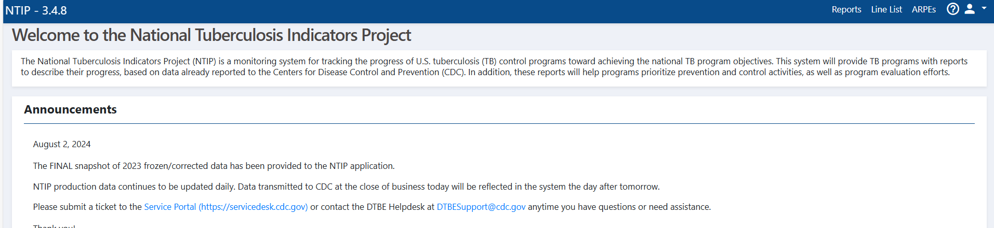
Select the ARPE Option

Slide 10
Final 2024 ARPE

Slide 11

Select “Search ARPE Forms””
Since you already entered preliminary 2024 data last year, you do not need to create a new ARPE form for the final 2024 data.

Slide 12
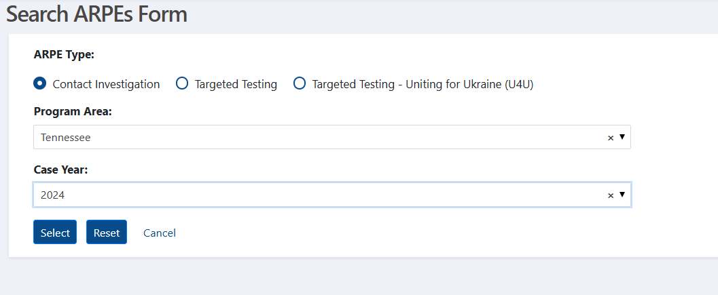
Choose the 2023 ARPE Report
Make sure “Contact Investigation” is selected
Select your program area
Select “2024”

Slide 13
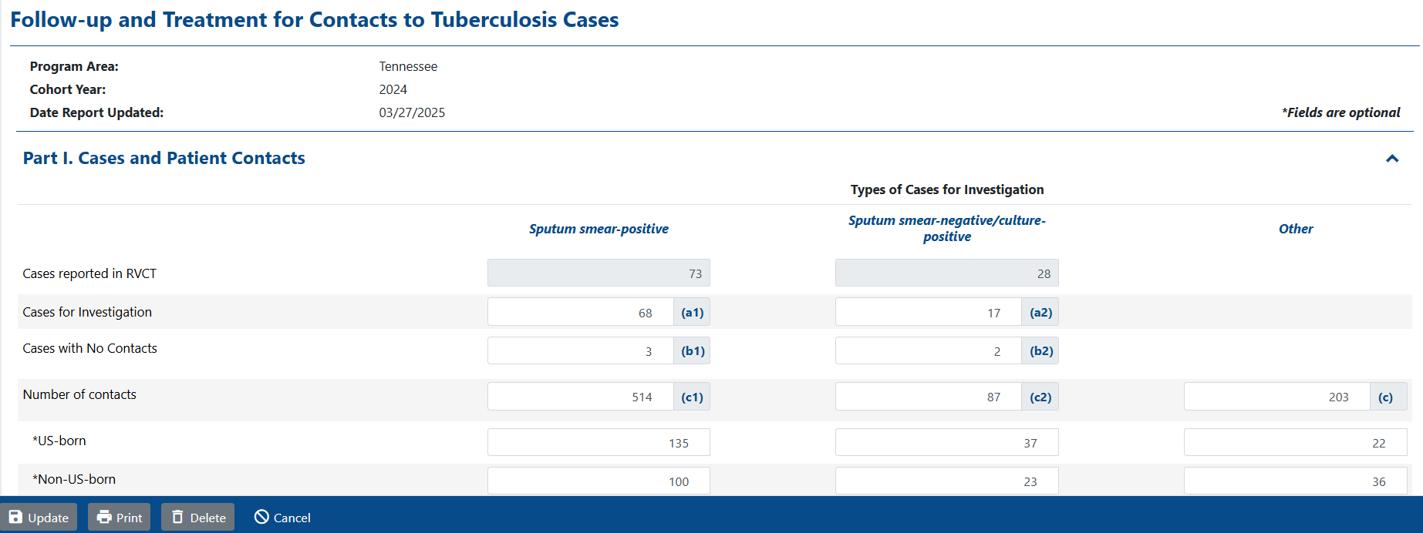
Update Your Previous 2024 Submission
Once you have updated the form, click “Update.”

Slide 14
Preliminary 2025 ARPE

Slide 15
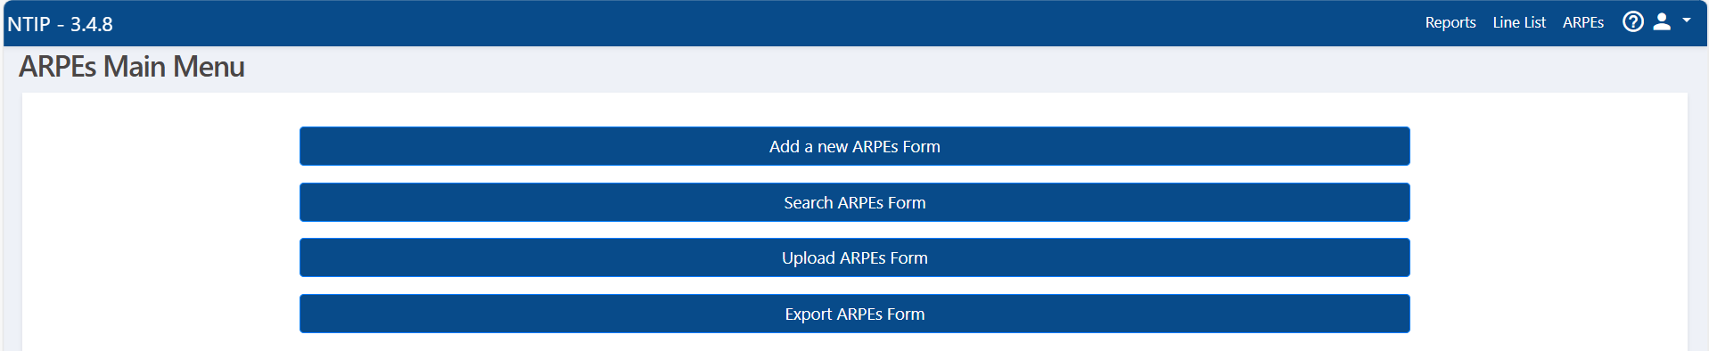
Select “Add a new ARPEs Form”

Slide 16
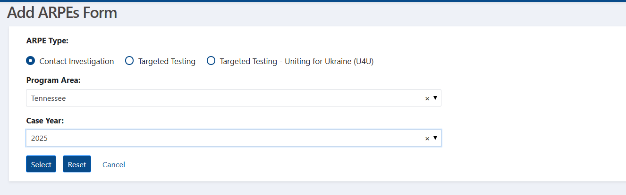
Begin to Add New ARPE
Make sure “Contact Investigations” is selected
Select your program area
Select “2025”

Slide 17
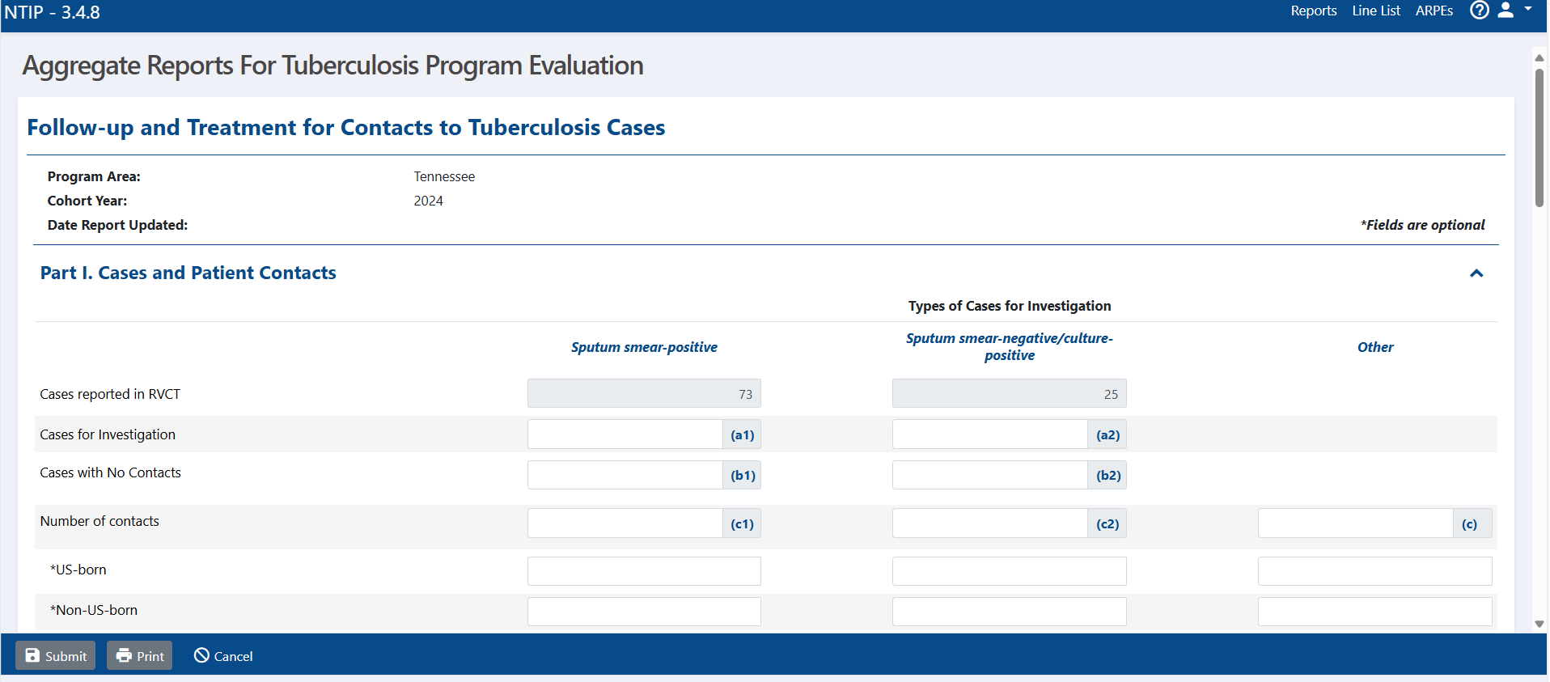
Add Your Data and Submit

Slide 18
Targeted Testing

Slide 19
CAVEAT
In 2024, targeted testing ARPEs were due for those jurisdictions with >150 cases.
In 2025, all jurisdictions were required to do targeted testing and must submit prelim 2025 targeted testing ARPE results.
SO…if you submitted a preliminary 2024 targeted testing ARPE last year, please update with final 2024 numbers.
EVERYONE should submit a preliminary 2025 targeted testing ARPE report per the Cooperative Agreement.

Slide 20
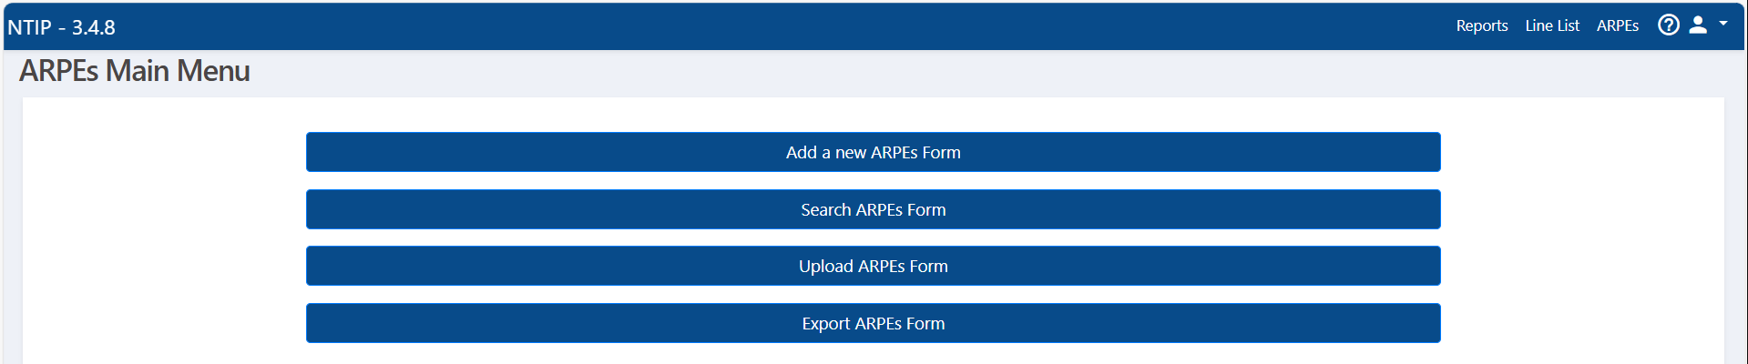
Search ARPE Forms
If you previously submitted preliminary 2024 Targeted Testing data, search for that ARPE form.

Slide 21
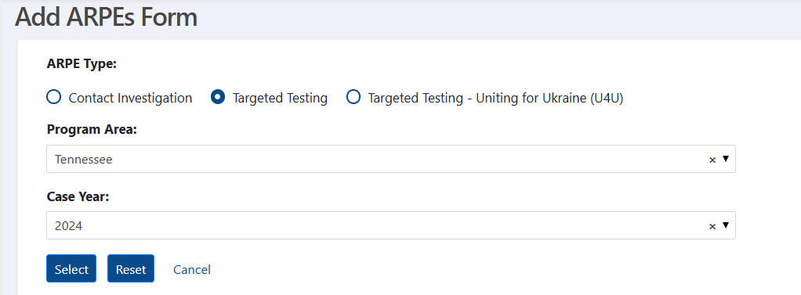
Select the 2024 ARPE Form
Make sure “Targeted Testing” is selected
Select your program area
Select “2024”

Slide 22
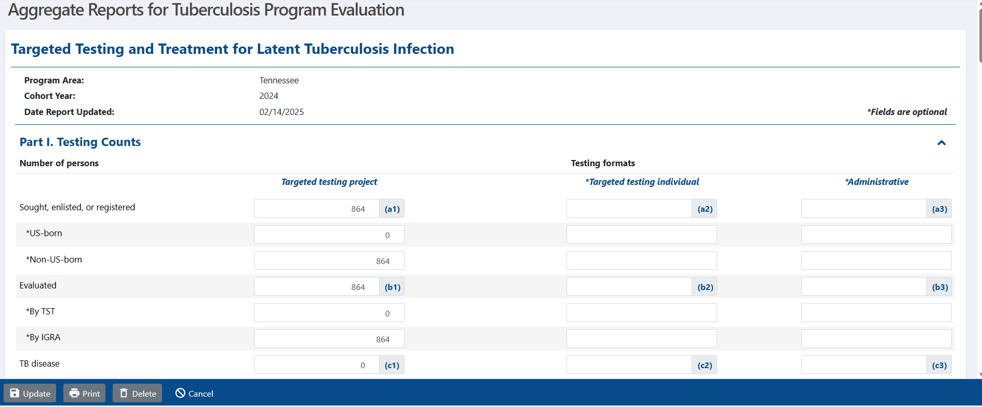
Update 2024 Targeted Testing Numbers

Slide 23
Creating Preliminary 2025 Targeted Testing ARPE

Slide 24
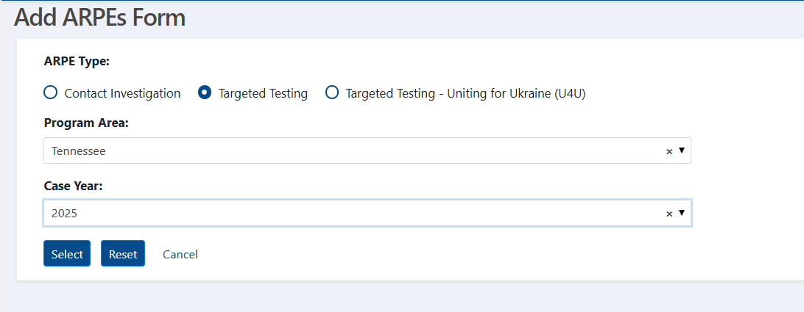
Adding Prelim 2025 Targeted Testing ARPE
Make sure “Targeted Testing” is selected
Select your program area
Select “2025”

Slide 25
United for Ukraine (U4U) ARPEs

Slide 26
Uniting for Ukraine ARPEs
Uniting for Ukraine ARPEs are no longer due.
If you submitted preliminary 2024 ARPEs for U4U, update with final numbers.
If you are still testing Ukrainians, it is your choice whether you want to enter preliminary 2025 data.

